Slide 1
COE – Teacher Supervisors Mileage Travel request

Slide 2
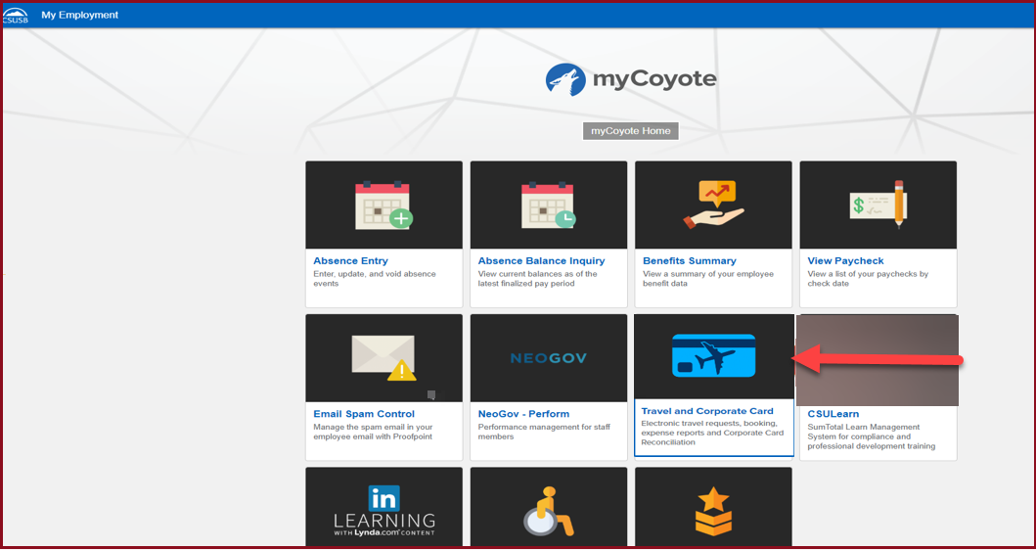
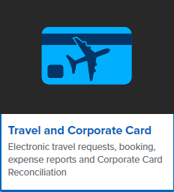
On the single sign on page, type in your mycoyote ID and password, hit enter and then either choose My Employment or, Administrative Systems and click on the Travel and Corporate card Icon as shown below:

Slide 3
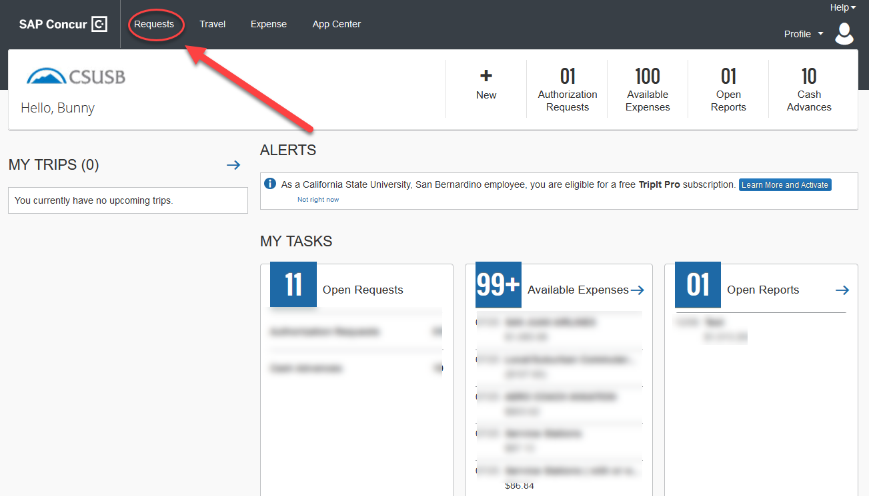
To begin a Travel Request, click on Requests as shown below
Notes:
This page is your home page
Go over all information on this page

Slide 4
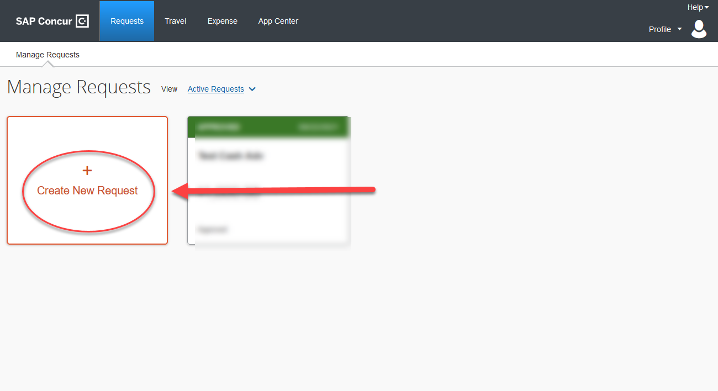
Click on Create New Request

Slide 5
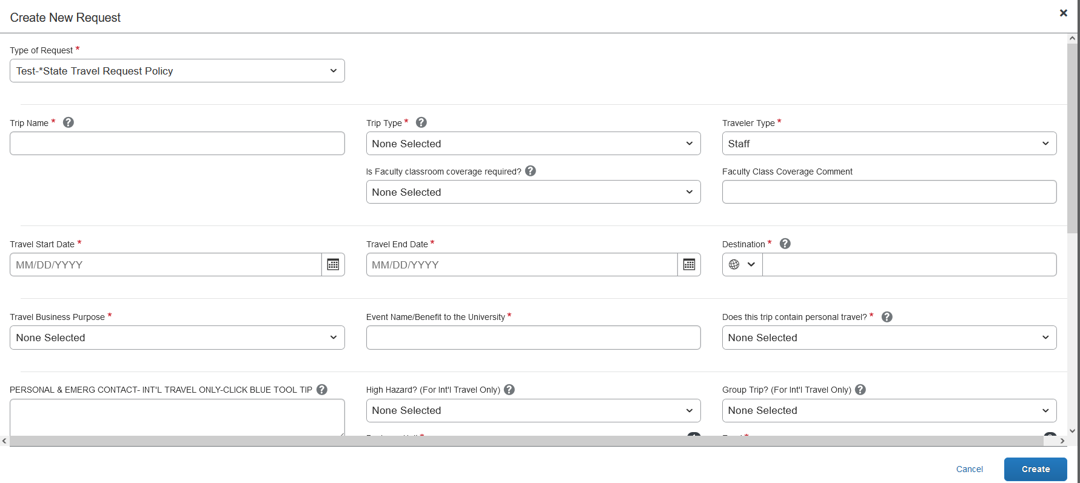
Input your travel information on the Request Header. Each required text box is noted by the red asterisk on the top of the box. Use the down arrows and the calendar when available on each box. After entering all the required information click on create. If you need the chart field string please contact your division or department administrative person.

Slide 6
Request Header Components
Type of Request – This is the funding source of your trip, either it can be State Policy or Auxiliary Policy
Trip Name Please add a meaningful name based on your business trip
Trip Type For Travel within state - choose instate, outside the state - out of state, and out of the country - international
Traveler Type Group Travel – trips sponsored by staff/faculty consisting a group of students, Team Travel – Athletics Team trips
Travel Business Purpose Please choose the appropriate business purpose related to the trip
Event Name/Benefit to the University This can be the same as the Trip Name
Does this trip contain personal travel Answer Yes or, No . If answer is Yes, attach the comparison price to the Request
Personal & Emerg Contact/High Hazard/Group Trip Required to fill the 3 boxes, if the trip is international
Chart Field String Information If you are unaware of the account numbers, contact your department
Business Unit – Type the business unit in the box, and select from the dropdown list that appears below
Fund – Type the fund in the box, and select from the dropdown list that appears below
Department – Type the department in the box, and select from the dropdown list that appears below
Program – The program code is NONE. Please type NONE and select from the dropdown list that appears below
Project – The project code is NONE for Stateside. Please type NONE and select from the dropdown list that appears below
Approver – Choose the correct approver of your department from the list that appears in the box
Class Code – Type the class code, if you have one and select from the dropdown list

Slide 7
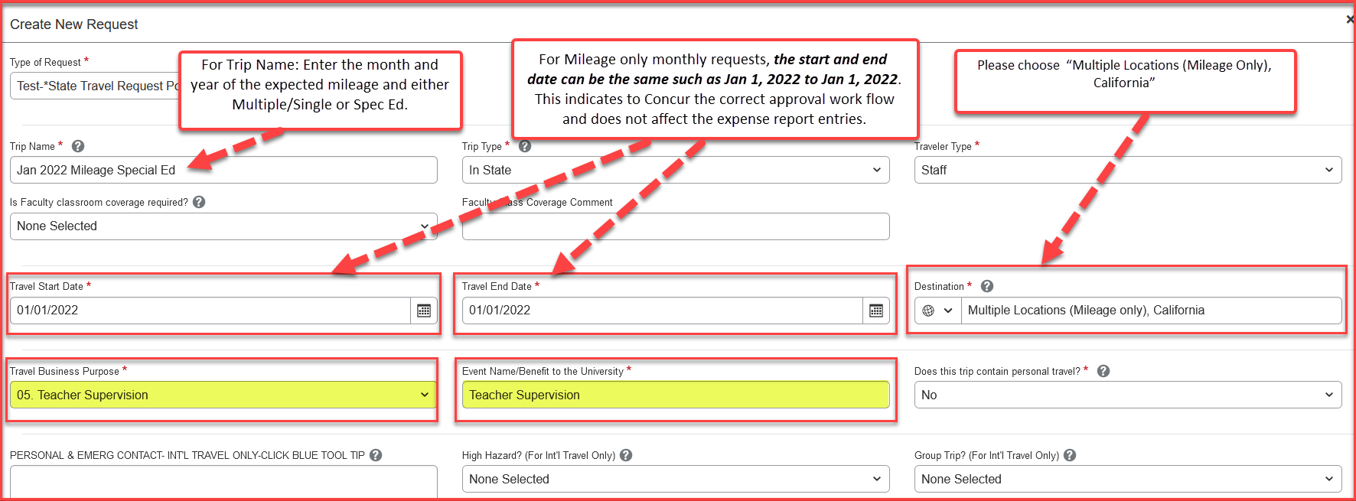
Input your travel information on the Request Header
Below is an example of what should go in each required text box
Use the down arrows and select from the drop-down list

Slide 8
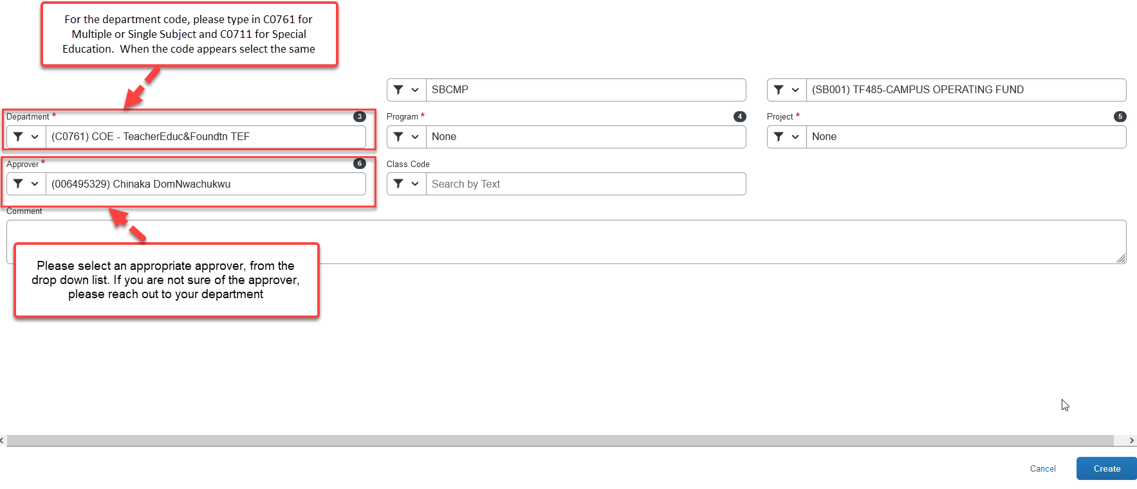

Slide 9
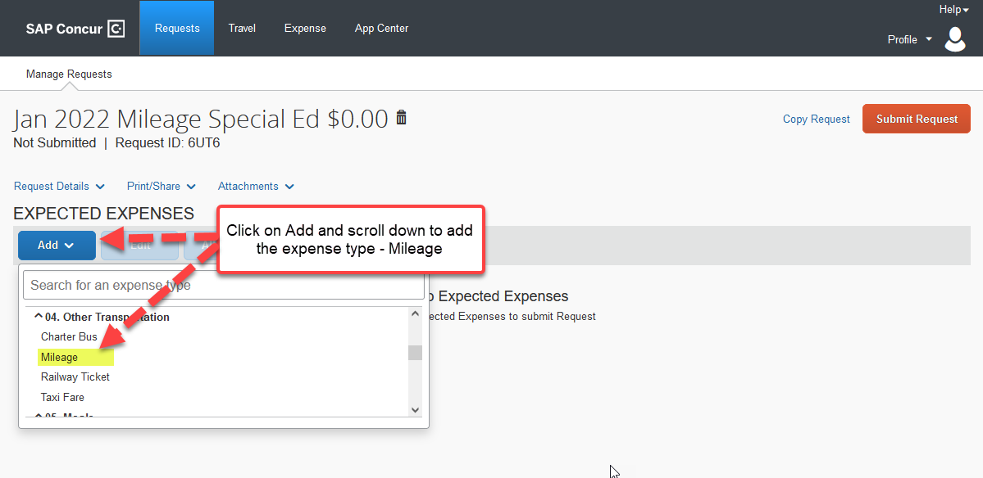
Adding Expenses

Slide 10
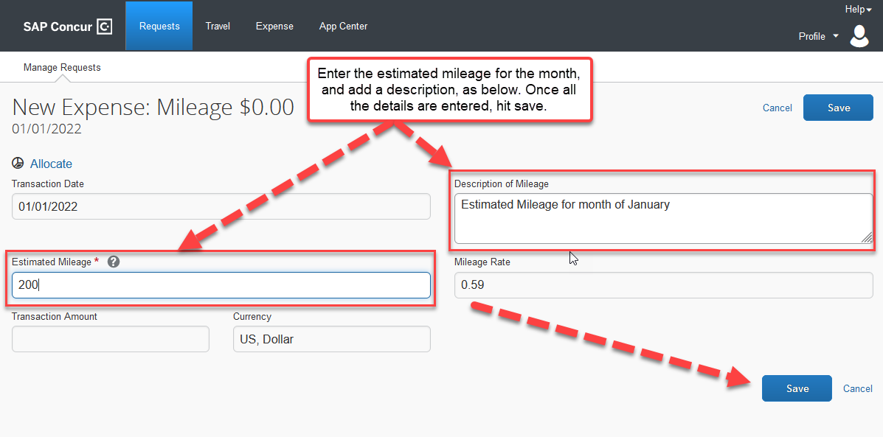
Enter the Estimated Mileage for the month, and add a description, as shown below. Once all the details are filled in, click on save at the bottom of the page.
The amounts entered in segments for airfare, domestic hotel and rental car will appear here as estimated expenses in addition to the ones entered from the expenses tab.

Slide 11

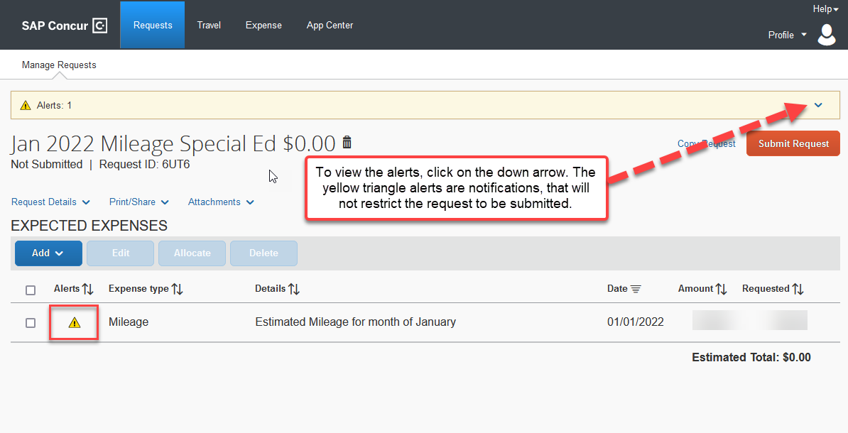
Alerts: alerts with the red exclamation ! needs to be cleared. The yellow triangle alerts are notifications
Once all the red alerts are cleared, you are ready to submit the Request!

Slide 12
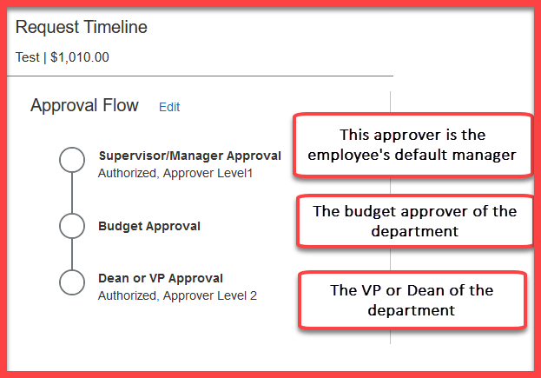
Approval Flow is now called Request Timeline
Please note: each approvers have 9 days to approve a Request, failing which the Request gets timed out, and the user will have to resubmit the Request.

