Slide 1
Updating Concur profile and delegate information

Slide 2
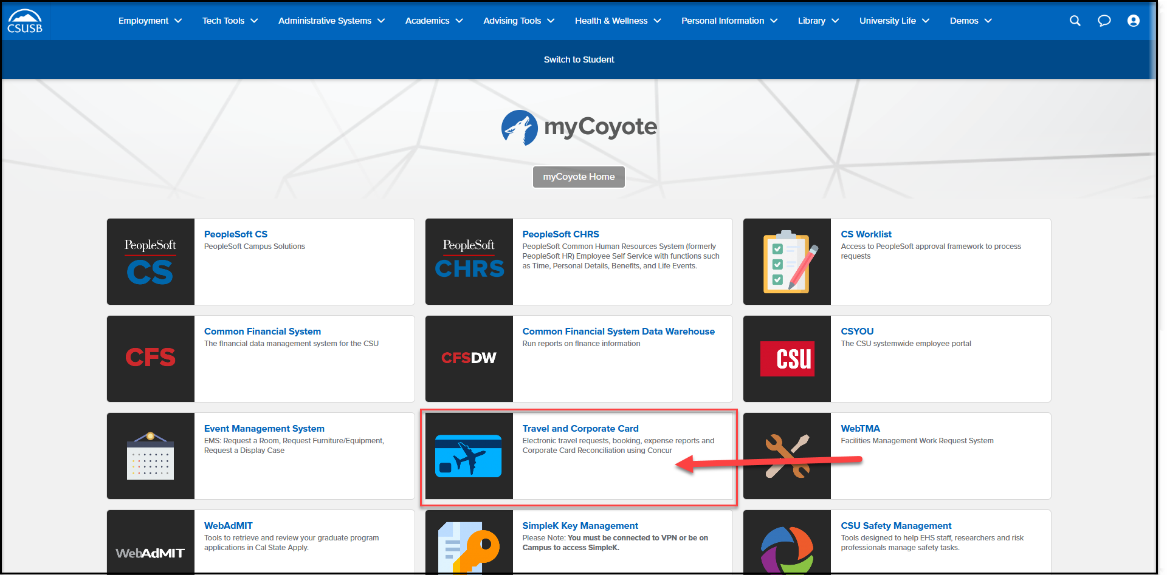
On the single sign on page, type in your mycoyote ID and password, hit enter and then either choose My Employment or, Administrative Systems and click on the Travel and Corporate card Icon as shown below:

Slide 3
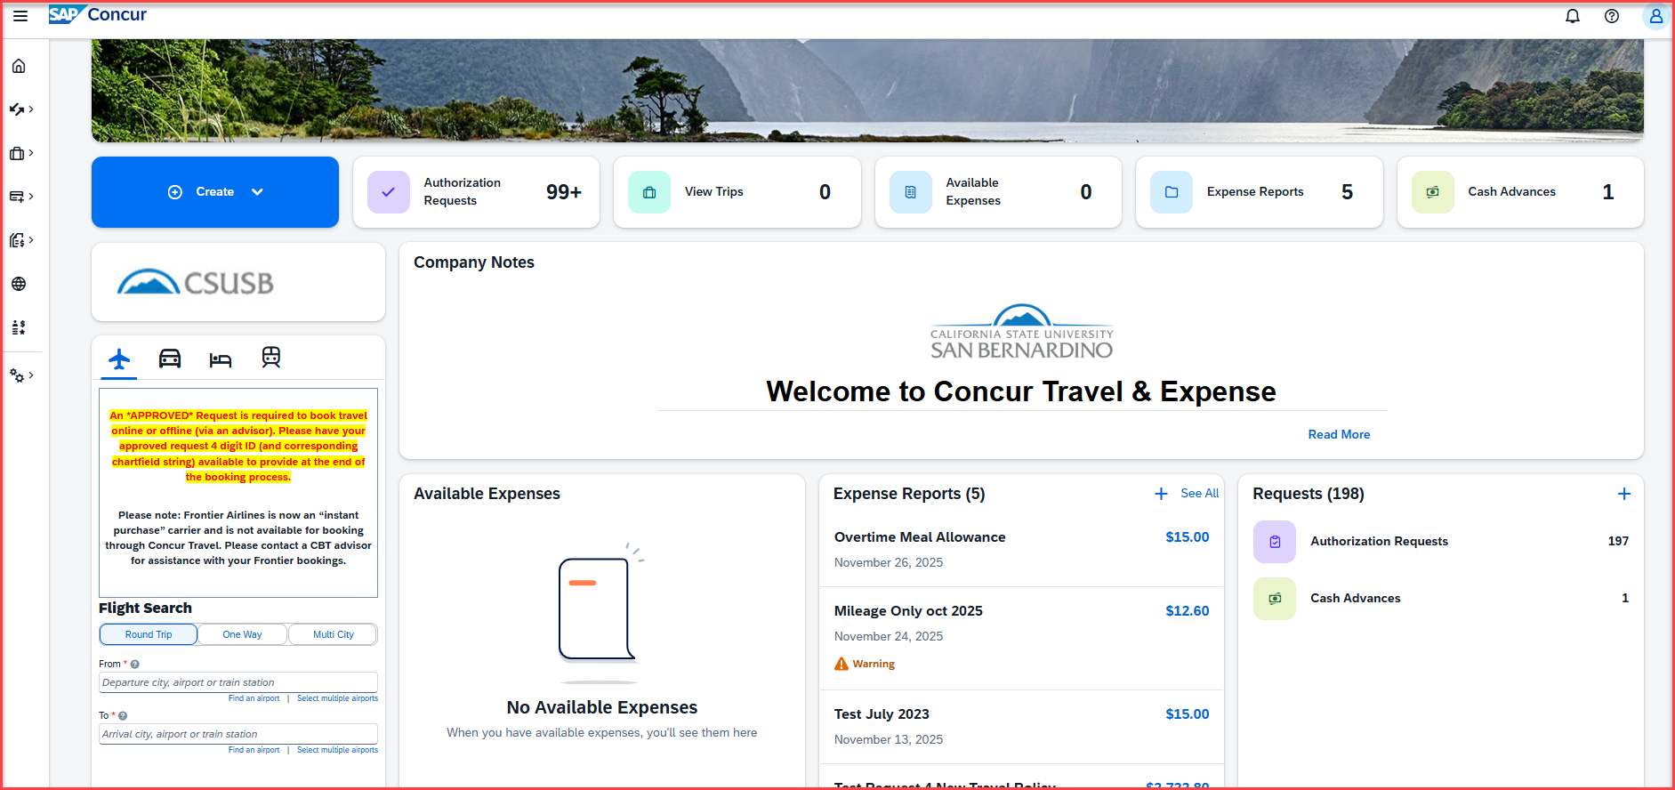
Successful Log On! You are now on the Concur landing page.
Notes:
This page is your home page
Go over all information on this page

Slide 4
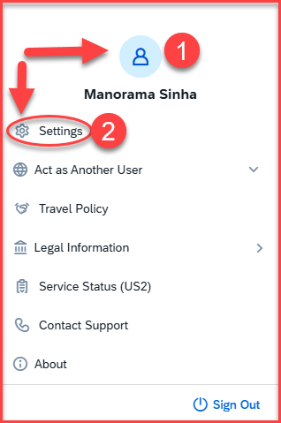
Updating Your Profile
Click on Profile icon on the right-hand side top corner, then Settings to assign a travel assistant, a travel request and expense report delegate, input frequent flyer and/or hotel and car reward programs and update personal information.

Slide 5
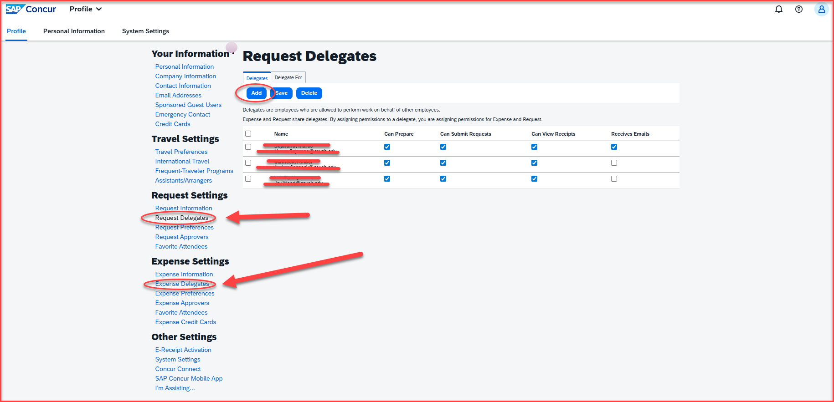
Assigning a Request & Expense Delegate
Select Request Delegates or Expense Delegates, under Request Settings or Expense Settings, and click on Add
A delegate is the one that can create a request, or expense report. A delegate can also submit a request on behalf of a traveler but cannot submit an expense report. The expense report must be submitted only by the traveler

Slide 6
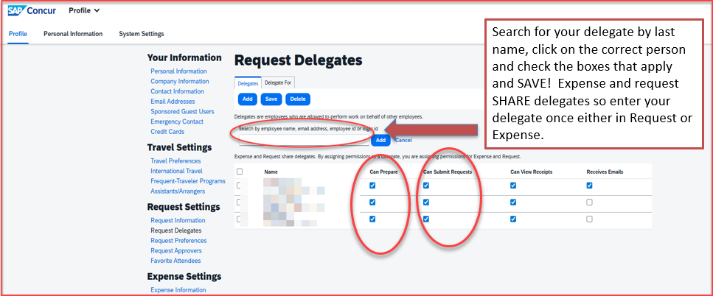
Assigning a Request & Expense Delegate

Slide 7
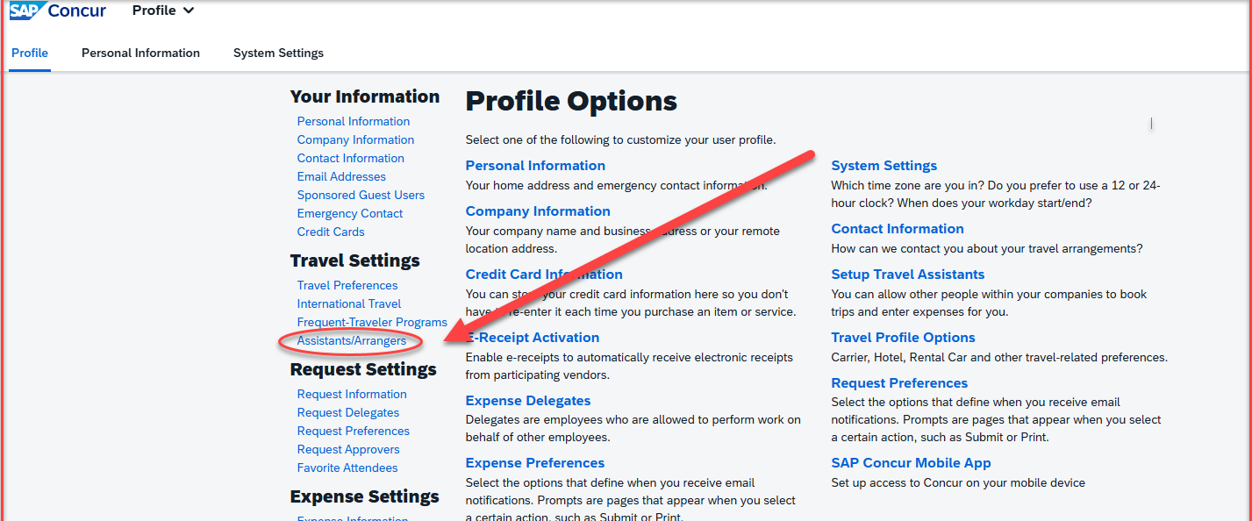
Assigning a Travel Assistant/Arranger
Click on Assistants/Arrangers under Travel Settings.
A travel assistant arranger is the one who can book an airline ticket/hotel/car rental for an employee

Slide 8

Assigning a Tarvel Assistant/Arranger

Slide 9
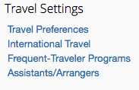
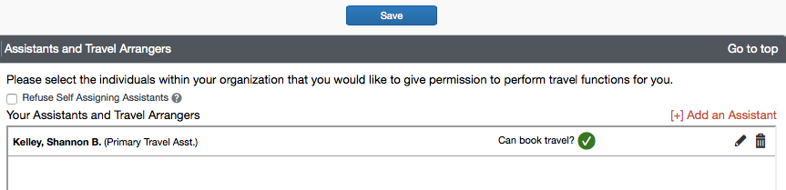
Assigning a Travel Assistant/Arranger
To assign a travel assistant in profile settings, on the left side column choose Assistants/Arrangers under Travel Settings. Click on “add an assistant”, enter their last name and save the entry.

Slide 10
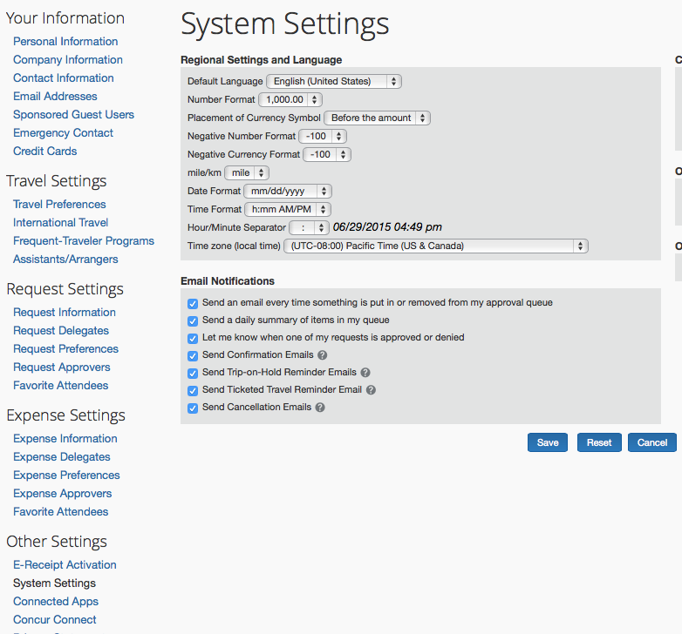
Email Notifications
In your profile, click on System Settings and approvers can choose to be notified each time something is put in or removed from their queue OR receive a daily summary. This is available to both approvers and users for email notification changes.
To turn the notification(s) off simply uncheck the box. Notifications can be turned back on by re-checking the box(es).

Slide 11
Thank you!
If further information or assistance is needed, please do not hesitate to contact Travel office, at 909-537-5155 or travel@csusb.edu.

