Slide 1
Create a Mileage only expense report

Slide 2
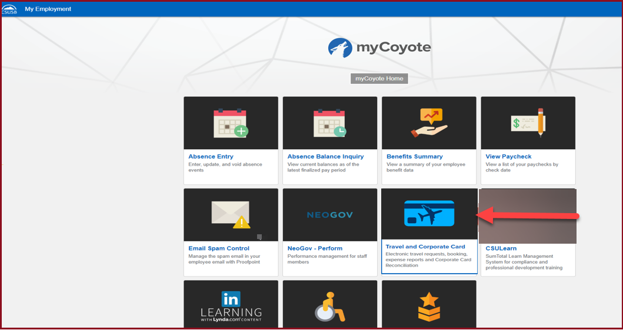
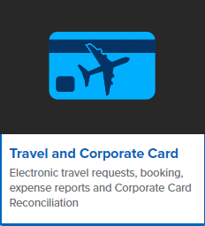
On the single sign on page, type in your mycoyote ID and password, hit enter and then either choose My Employment or, Administrative Systems and click on the Travel and Corporate card Icon as shown below:

Slide 3
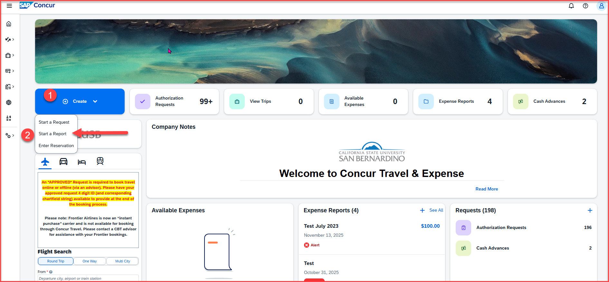
To begin the expense report, click on Create, then Start a Report

Slide 4
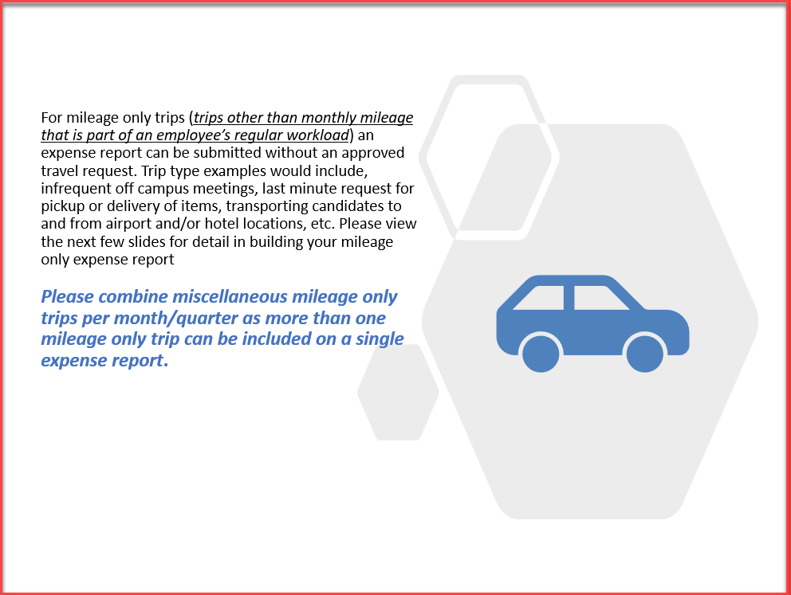

Slide 5
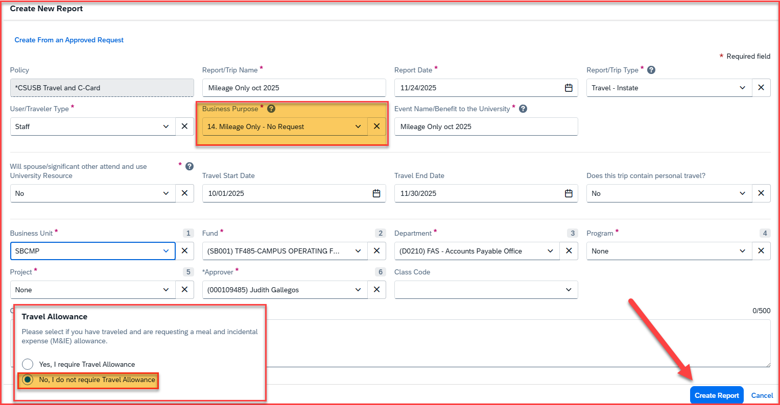
Report Header
The Travel Business Purpose must be number 14. Mileage Only - No Request
For a mileage only expense report, you must select – No under the Travel Allowance
If you are unsure of the business unit, fund, department ID, program or project number, or the appropriate approver, please reach out to your department for clarification. Once all the information has been filled into the Report Header, click on Create Report

Slide 6
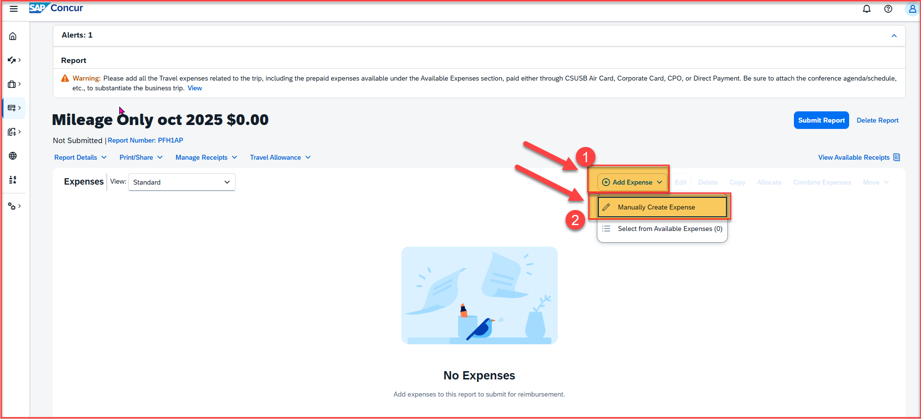
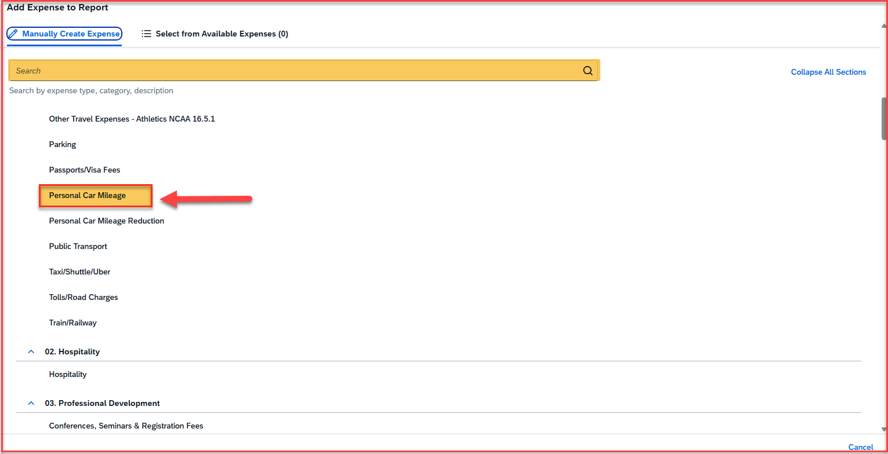
Adding Expenses
Once the report is created, click on Add Expense to start adding the personal car mileages
Click on Manually Create Expense and scroll down to add the Personal Car Mileage expense type. You can also search for an expense type, on the yellow highlighted box

Slide 7
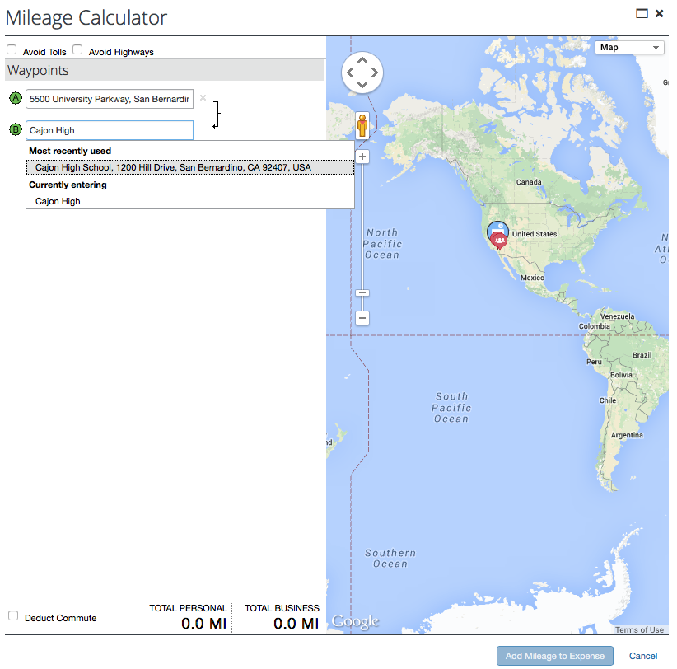
Adding the Mileage correctly
After clicking on Personal Car Mileage, a mileage calculator pops up. Please enter the beginning address and then add the locations visited. The system saves the most used destinations. Remember commute mileage is not reimbursable so use the address, home, or headquarters, closest to your destination. There is also a deduct commute button at the bottom on the left.
If you choose to click the deduct commute box below, a box will appear that will require your home and headquarters address. There is another deduct R/T commute mileage box that also needs to be checked.

Slide 8
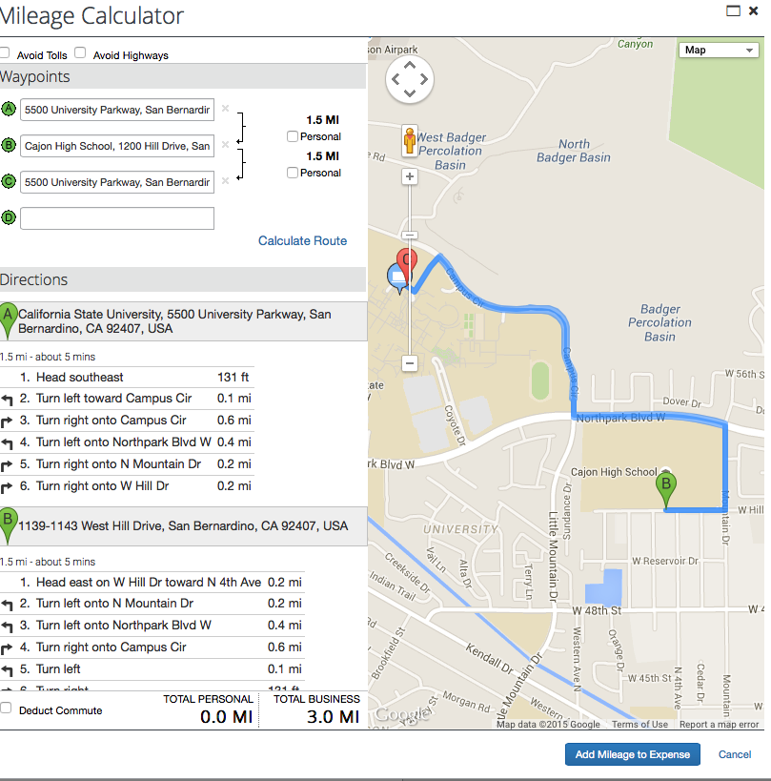
Enter each destination and click on calculate route to bring up the address and the next box. After entering the destination(s) for a single trip day, click calculate route again, (then click make round trip if necessary) and navigate to the bottom and click on “Add Mileage to Expense”.

Slide 9
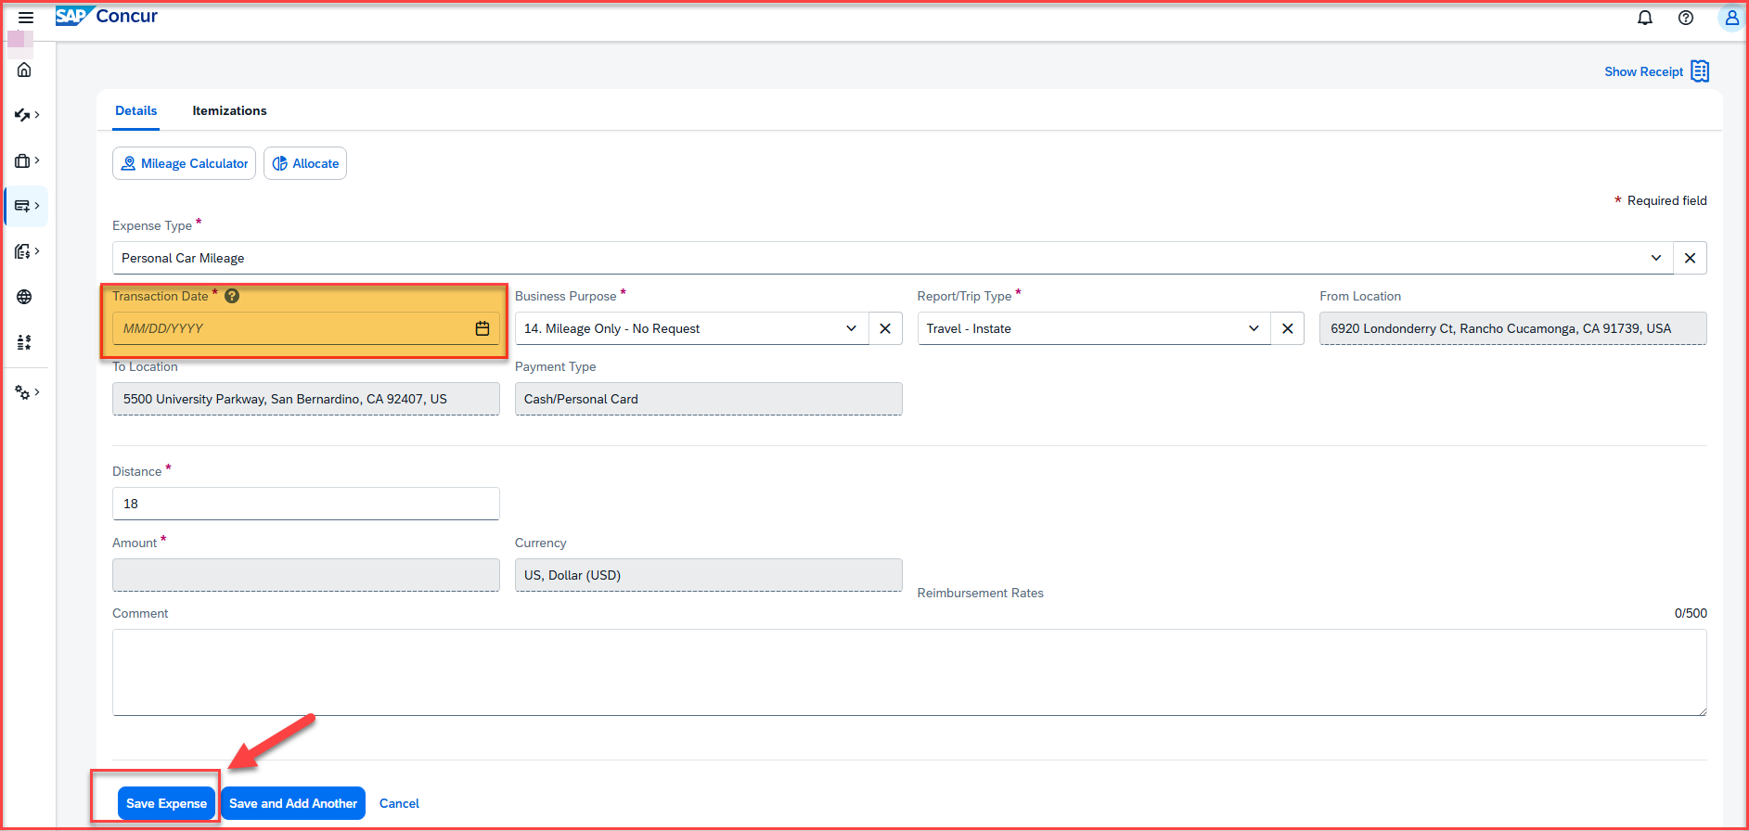
Enter the date of travel on the Transaction Date box. Be sure to click on the save expense button on the bottom of the page to save each entry. Comments specific to the trip may be added in the comment box for the approver to see.

Slide 10
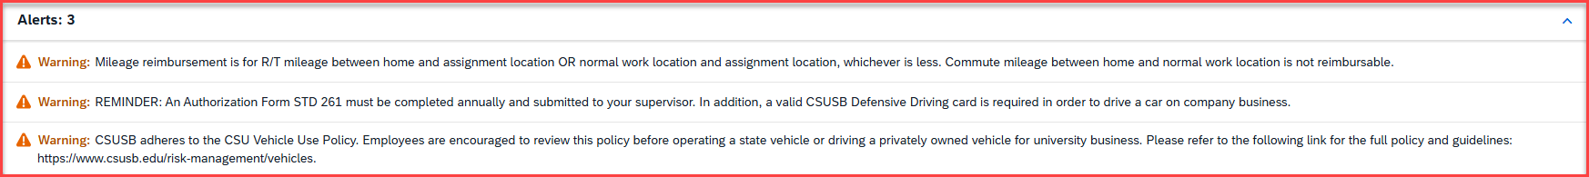
Alerts: For personal car mileage, there will always be the following 3 alerts, which are reminders
Reminder: Mileage reimbursement is only allowed for round-trip mileage between the employee’s home and the assignment location or between the normal work location and the assignment location—whichever distance is less. Commute mileage between home and the normal work location is not reimbursable.
Reminder: The Authorization Form STD 261 must be completed annually and submitted to your supervisor. Additionally, a valid CSUSB Defensive Driving card is required for any employee who operates a vehicle for university business.
Reminder: Employees are encouraged to review the CSU Vehicle Use Policy before driving a state vehicle or a privately owned vehicle for university business.
Please note that these reminders will continue to appear even if an employee has already completed all the requirements listed above. These alerts are informational only and do not prevent an employee from submitting an expense report.

Slide 11
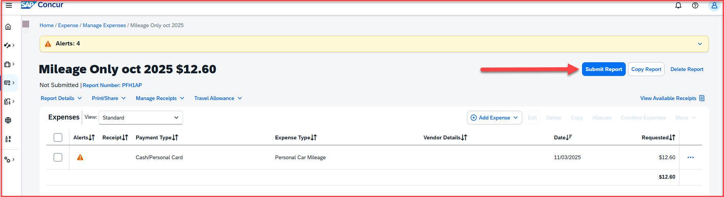
Once all the mileage entries are added, click on Submit Report

Slide 12
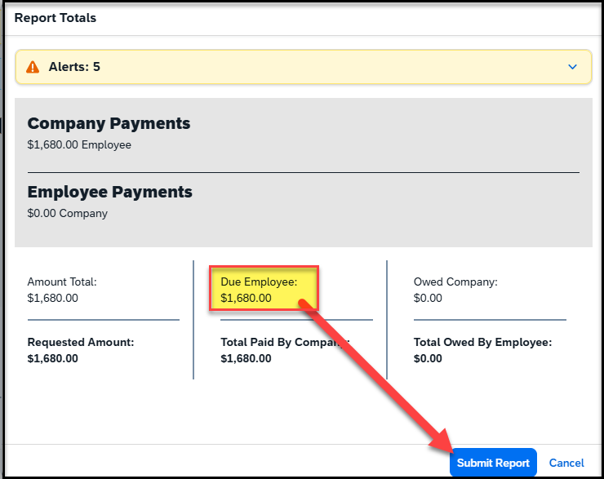
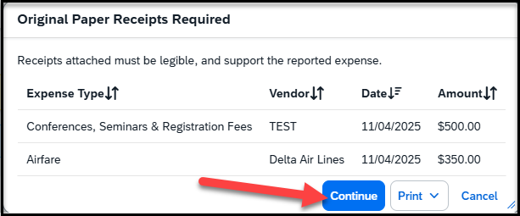
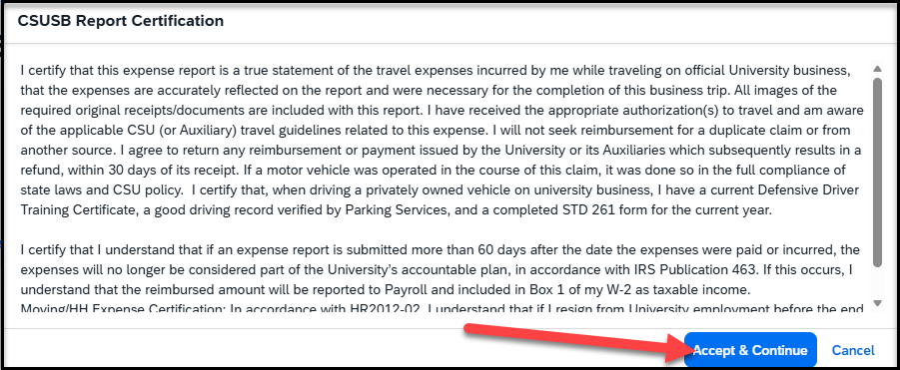
Once you click on Submit Report, the following screens will appear
This screen will show a breakdown of the report totals - Due Employee is the actual amount of reimbursement to the payee. Click on Submit Report
This screen shows that Original Paper Receipts are required, and then click on Continue
The CSUSB Report Certification page appears, click on accept & continue

Slide 13
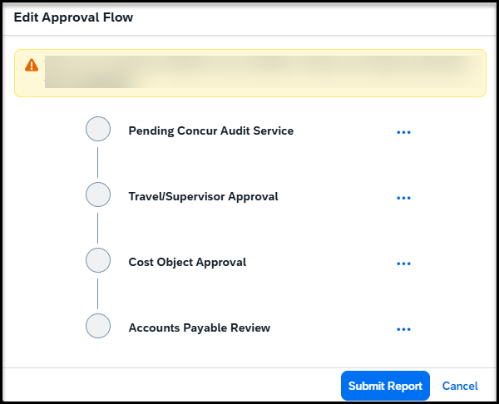
Once you click on continue, the approval Flow will appear
Concur Audit Service – known as Verify, is an AI tool that checks for checks for compliance issues, errors, and policy violations.
Travel/Supervisor Approval – This is the reports to/manager of the employee and will populate the name
Cost object Approval – This is the budget approver of the department. The name will be hidden behind the scenes, but it is the approver that was added to the header
Accounts Payable Review – This is the Accounts Payable department. All expense reports are reviewed and approved by accounts payable as the last approver

Slide 14
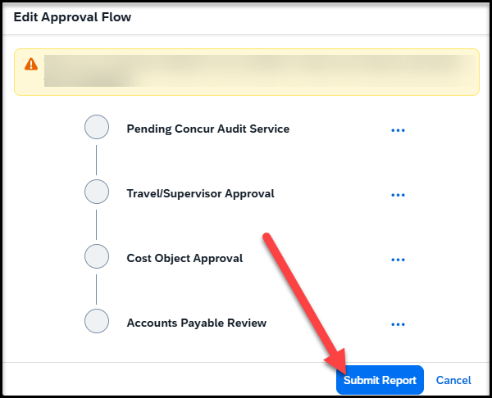
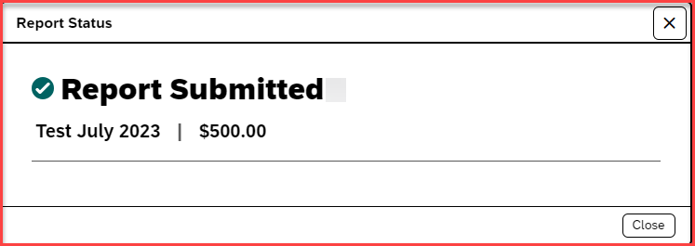
Once the Approval flow is reviewed, click on Submit Report – A pop-up will appear as Report submitted

Slide 15
THANK YOU!
If further information or assistance is needed, please do not hesitate to contact Accounts Payable/Travel at travel@csusb.edu or 909-537-5155.
Notes:
Updated August, 2017 CL

