Slide 1
Overtime work Hour's meal allowance reimbursement expense report

Slide 2
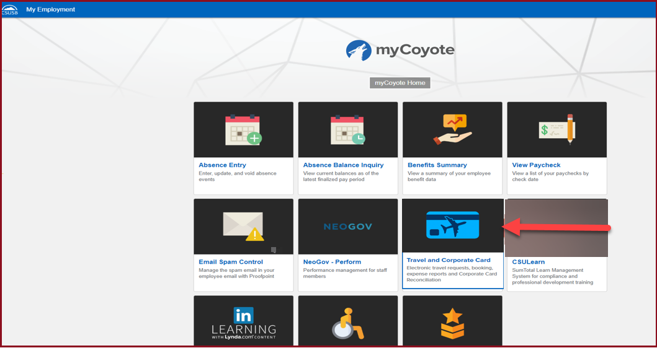
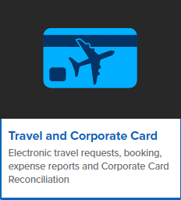
On the single sign on page, type in your mycoyote ID and password, hit enter and then either choose My Employment or, Administrative Systems and click on the Travel and Corporate card Icon as shown below:

Slide 3
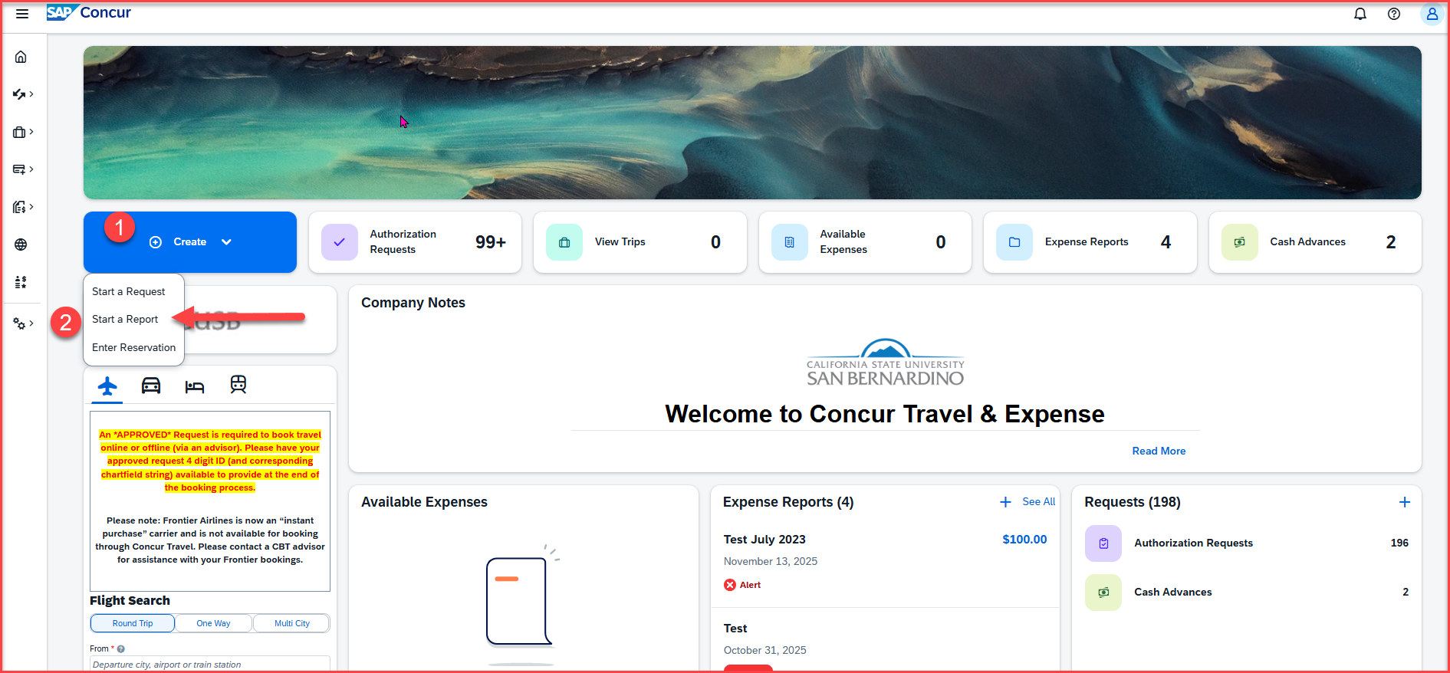
To begin the expense report, click on Create, then Start a Report

Slide 4
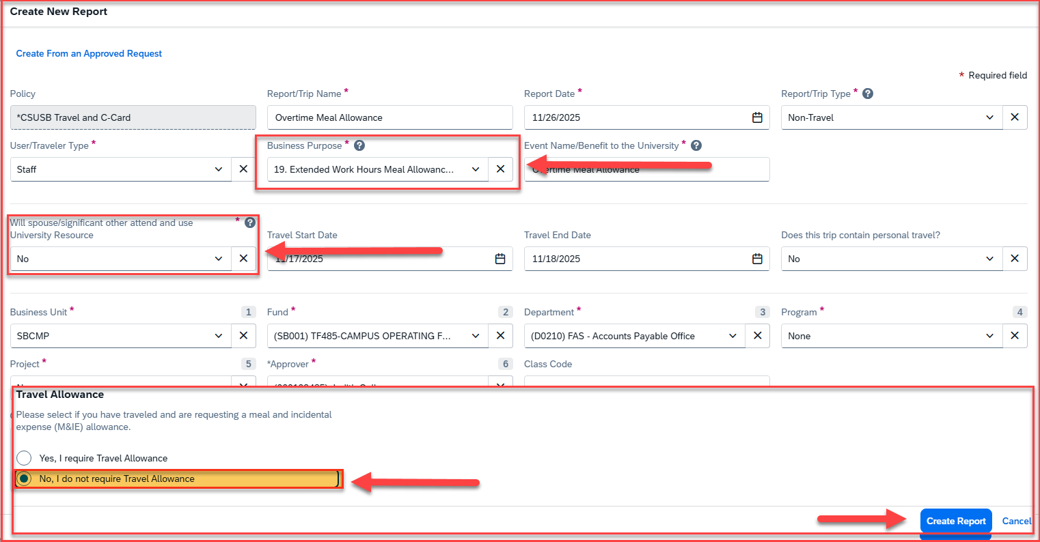
Select the Business Purpose: 19 Extended Work Hours Meal Allowance
Select No for the spouse/significant other attend and use box
Select No for the Travel Allowance and click on Create Report

Slide 5
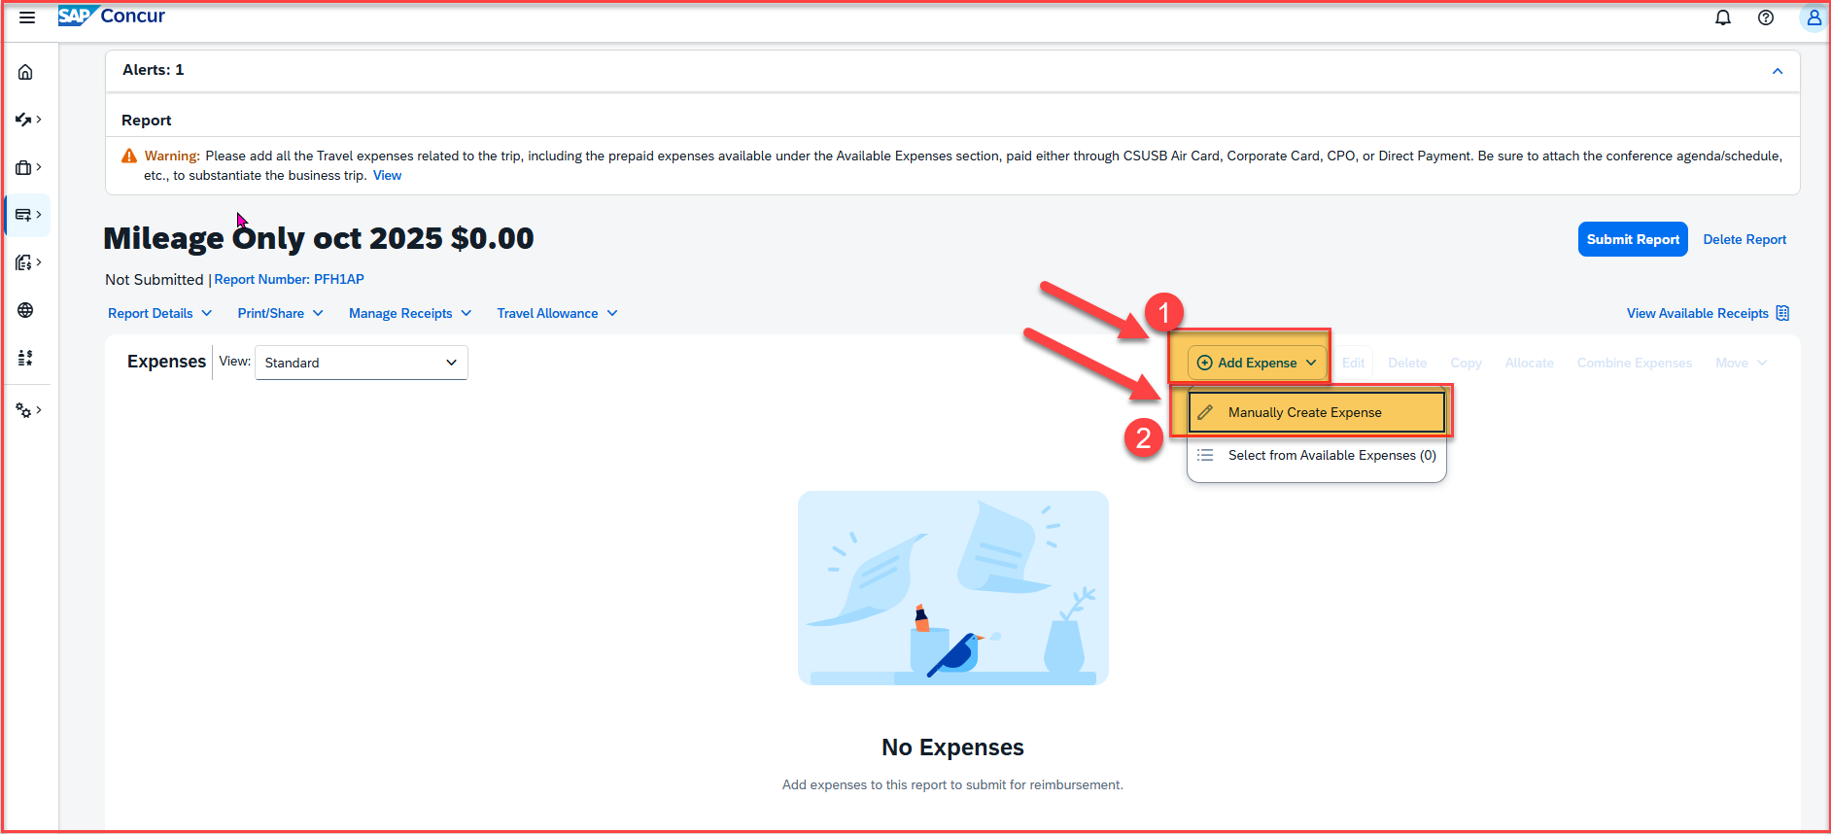
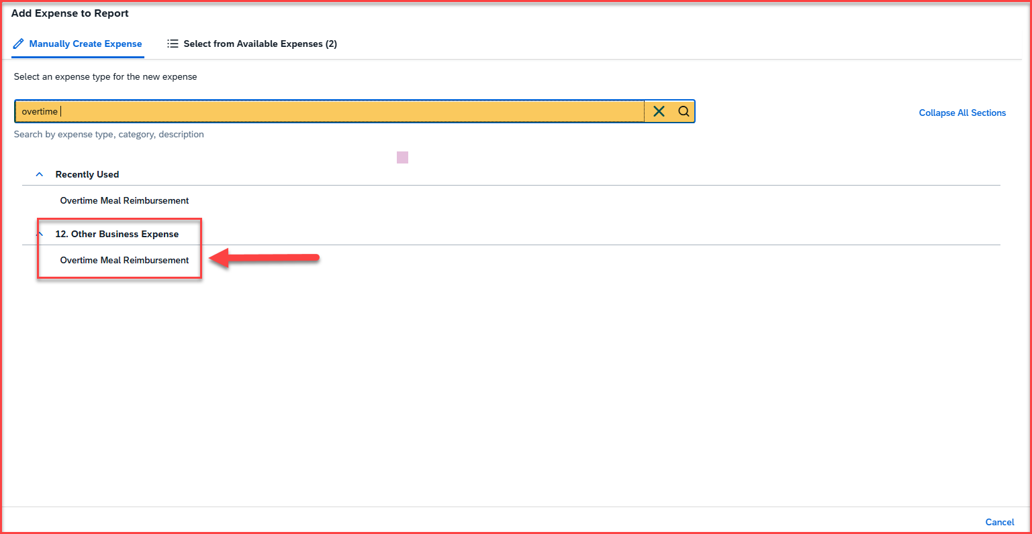
Adding Expenses
Once the report is created, click on Add Expense to start adding the overtime meal reimbursement expense type
Click on Manually Create Expense and scroll down to select the expense type. You can also search for an expense type, on the yellow highlighted box

Slide 6
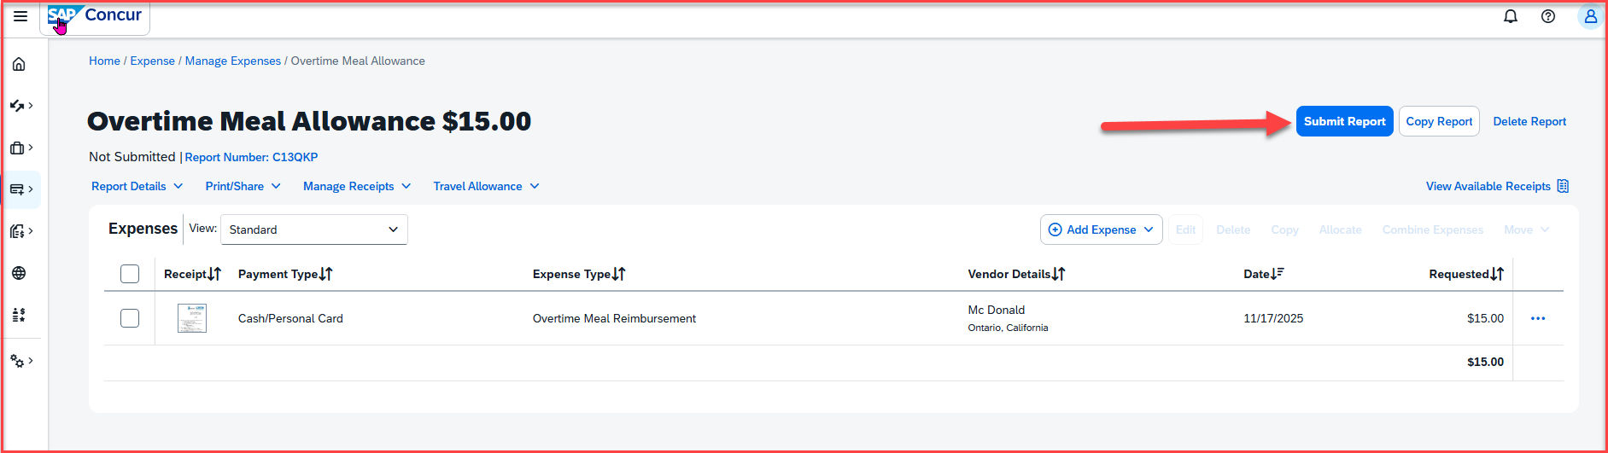
Submitting the Report
Once the expense type – Overtime Meal Reimbursement is saved, click on Submit Report

Slide 7
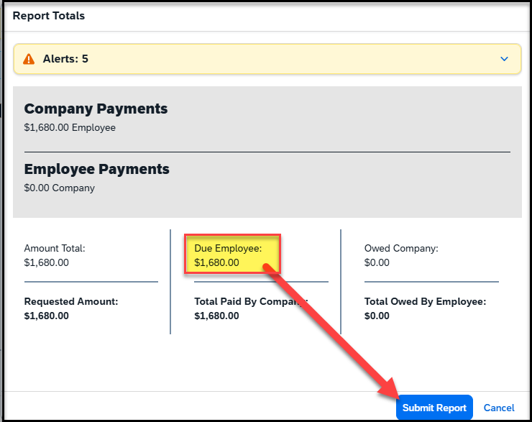
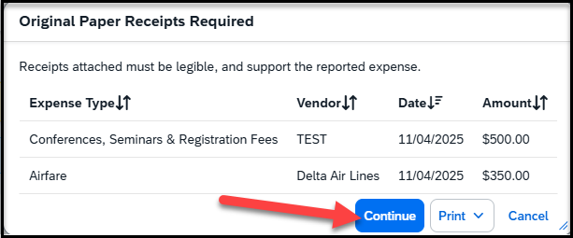
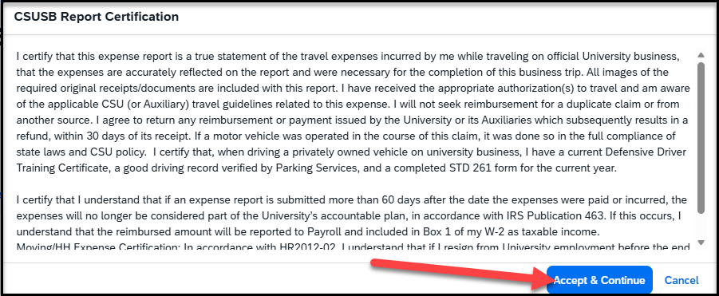
Once you click on Submit Report, the following screens will appear
This screen will show a breakdown of the report totals - Due Employee is the actual amount of reimbursement to the payee. Click on Submit Report
This screen shows that Original Paper Receipts are required, and then click on Continue
The CSUSB Report Certification page appears, click on accept & continue

Slide 8
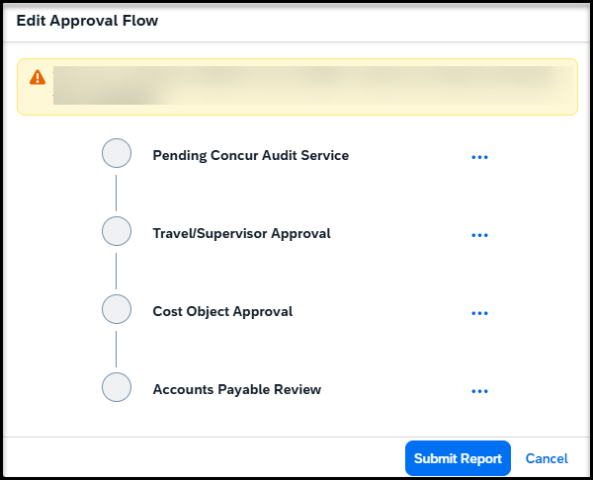
Once you click on continue, the approval Flow will appear
Concur Audit Service – known as Verify, is an AI tool that checks for checks for compliance issues, errors, and policy violations.
Travel/Supervisor Approval – This is the reports to/manager of the employee and will populate the name
Cost object Approval – This is the budget approver of the department. The name will be hidden behind the scenes, but it is the approver that was added to the header
Accounts Payable Review – This is the Accounts Payable department. All expense reports are reviewed and approved by accounts payable as the last approver

Slide 9
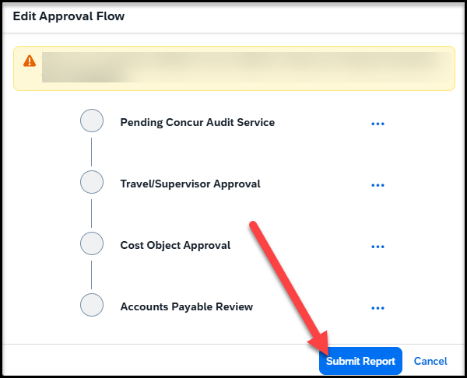
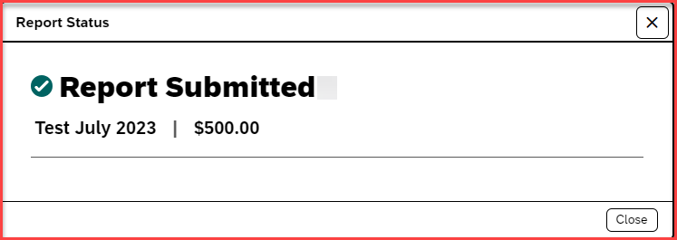
Once the Approval flow is reviewed, click on Submit Report – A pop-up will appear as Report submitted

Slide 10
THANK YOU!
If further information or assistance is needed, please do not hesitate to contact Accounts Payable/Travel at travel@csusb.edu or 909-537-5155.
Notes:
Updated August, 2017 CL

