Slide 1
Create an amended expense report

Slide 2
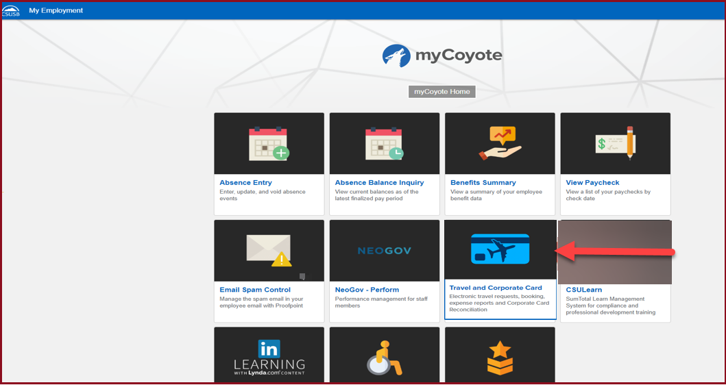
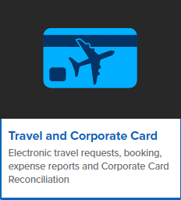
On the single sign on page, type in your mycoyote ID and password, hit enter and then either choose My Employment or, Administrative Systems and click on the Travel and Corporate card Icon as shown below:

Slide 3
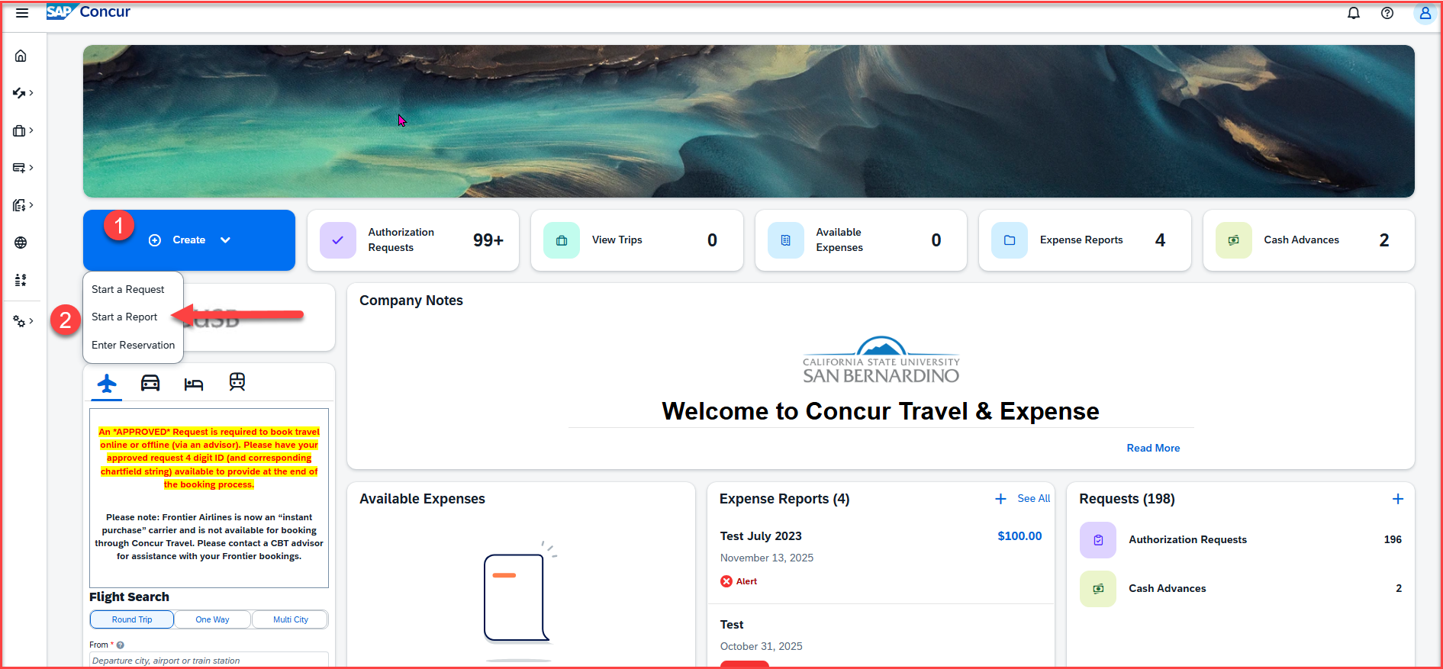
To begin the expense report, click on Create, then Start a Report

Slide 4
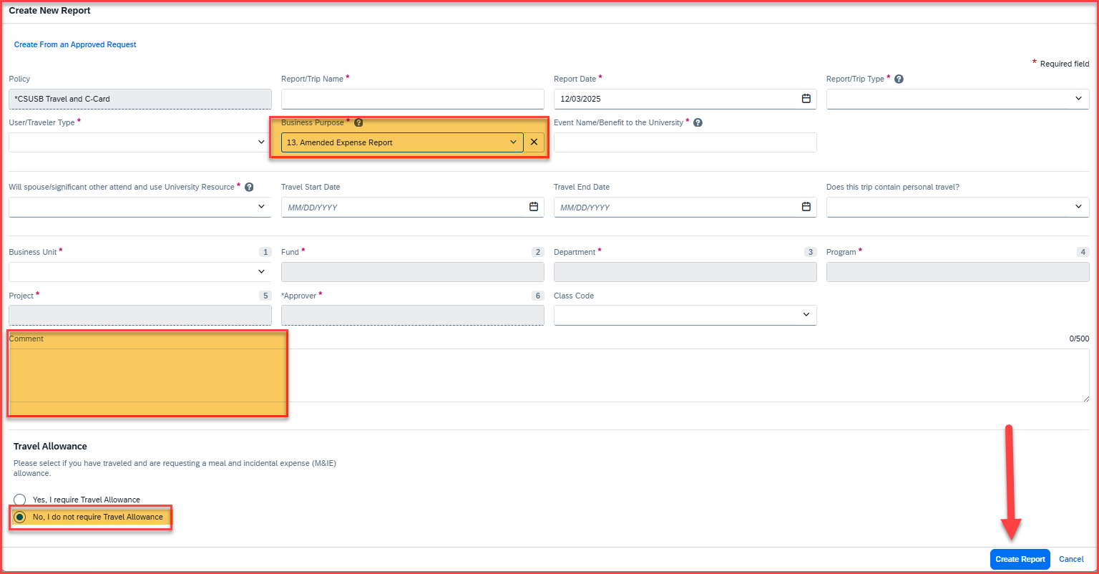
Report Header
The Travel Business Purpose must be number 13. Amended Expense Report
Please add the approved request ID to the comment box from the prior trip. All amended expense reports must have the approved request ID; otherwise, the system will restrict from submission of the report
Select No for Travel Allowance if no meals need to be added
Once all the other information has been filled into the Report Header, click on Create Report, available at the bottom corner

Slide 5
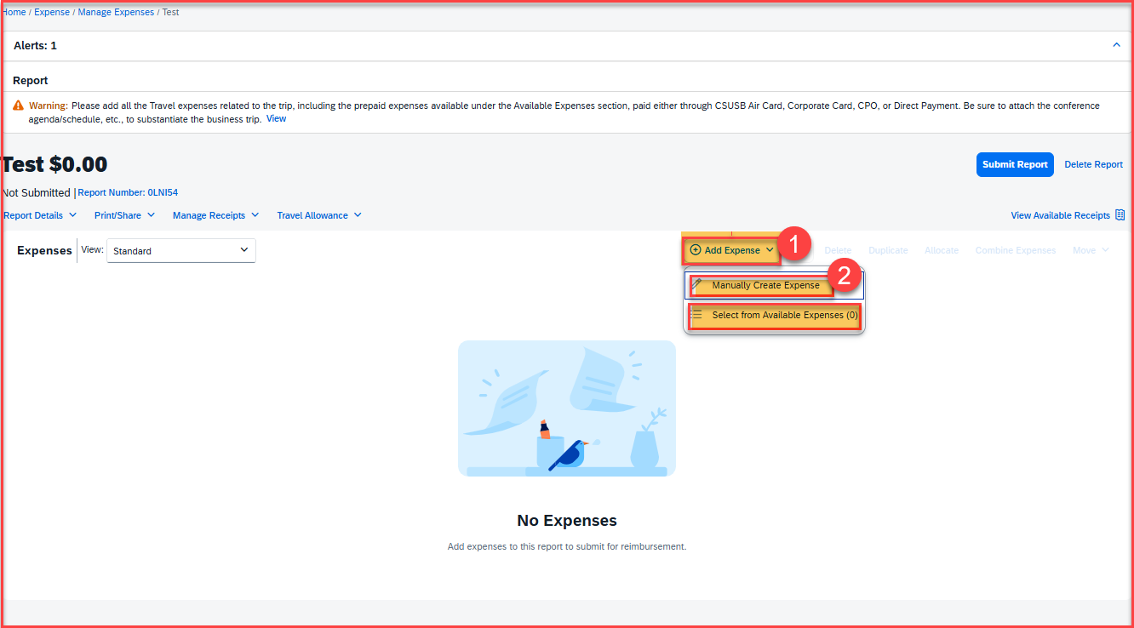
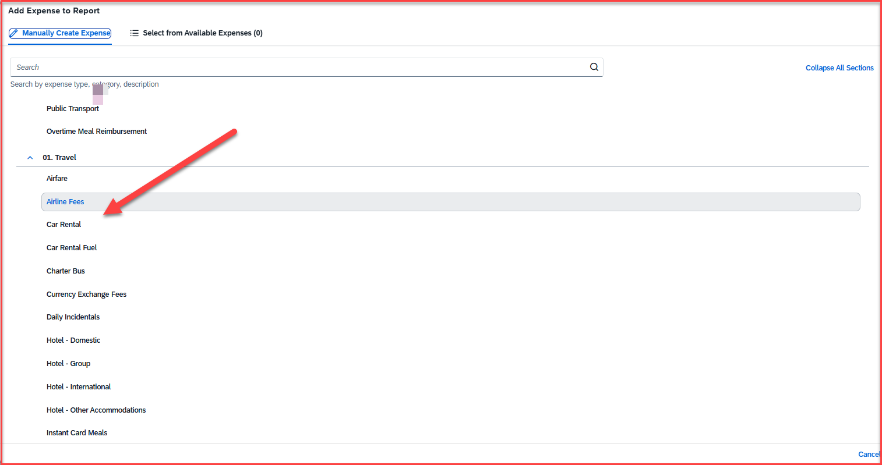
Adding Expenses
Click on +Add Expense > Either Manually Create Expense or Select from Available Expense
Add all the expenses that were missed on the earlier expense report

Slide 6
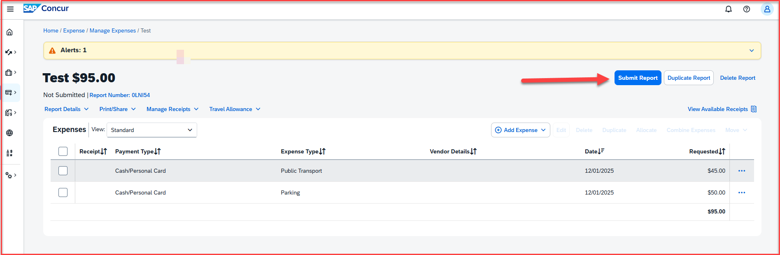
Adding Expenses
Once all the expenses are added, click on Submit Report, available in the right-hand corner

Slide 7
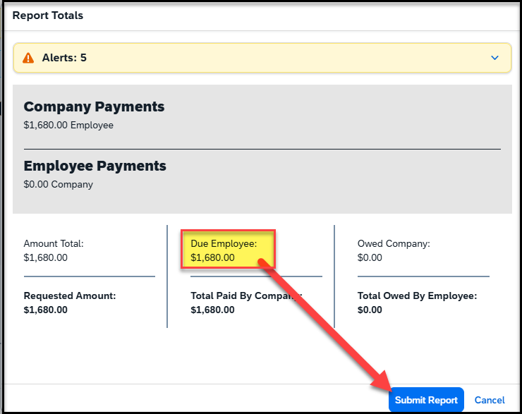
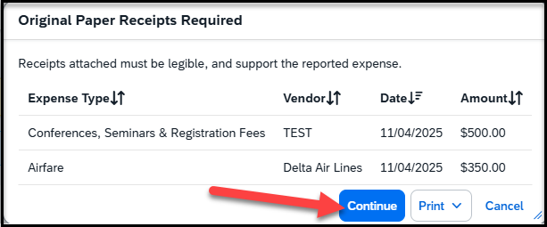
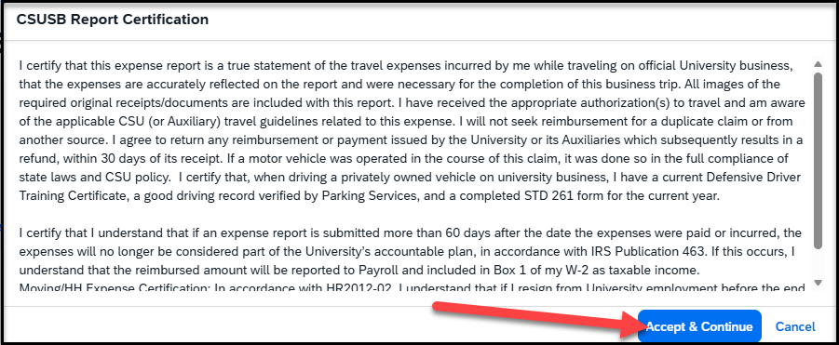
Once you click on Submit Report, the following screens will appear
This screen will show a breakdown of the report totals - Due Employee is the actual amount of reimbursement to the payee. Click on Submit Report
This screen shows that Original Paper Receipts are required, and then click on Continue
The CSUSB Report Certification page appears, click on accept & continue

Slide 8
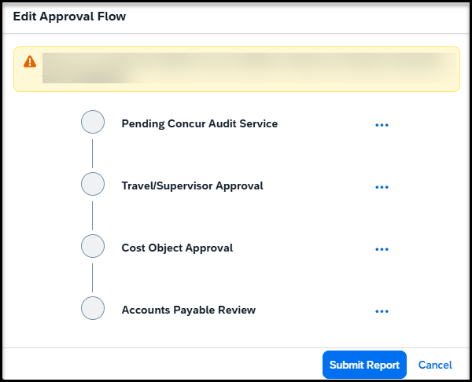
Once you click on continue, the approval Flow will appear
Concur Audit Service – known as Verify, is an AI tool that checks for checks for compliance issues, errors, and policy violations.
Travel/Supervisor Approval – This is the reports to/manager of the employee and will populate the name
Cost object Approval – This is the budget approver of the department. The name will be hidden behind the scenes, but it is the approver that was added to the header
Accounts Payable Review – This is the Accounts Payable department. All expense reports are reviewed and approved by accounts payable as the last approver

Slide 9
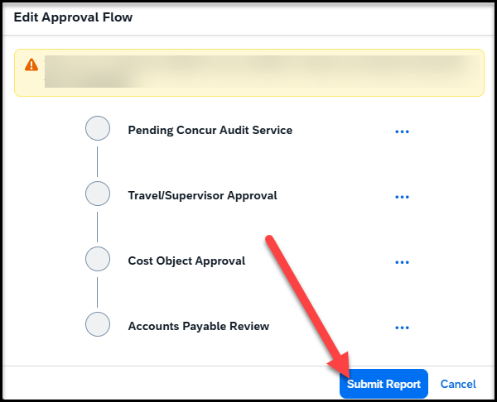
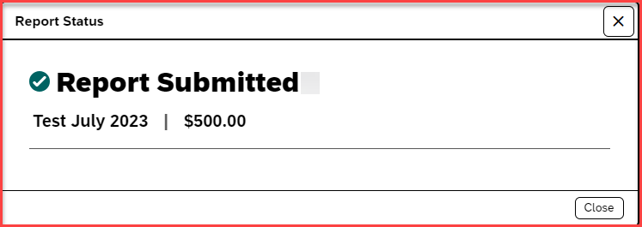
Once the Approval flow is reviewed, click on Submit Report – A pop-up will appear as Report submitted

Slide 10
THANK YOU!
If further information or assistance is needed, please do not hesitate to contact Accounts Payable/Travel at travel@csusb.edu or 909-537-5155.
Notes:
Updated August, 2017 CL

