Slide 1
Create an international expense report

Slide 2
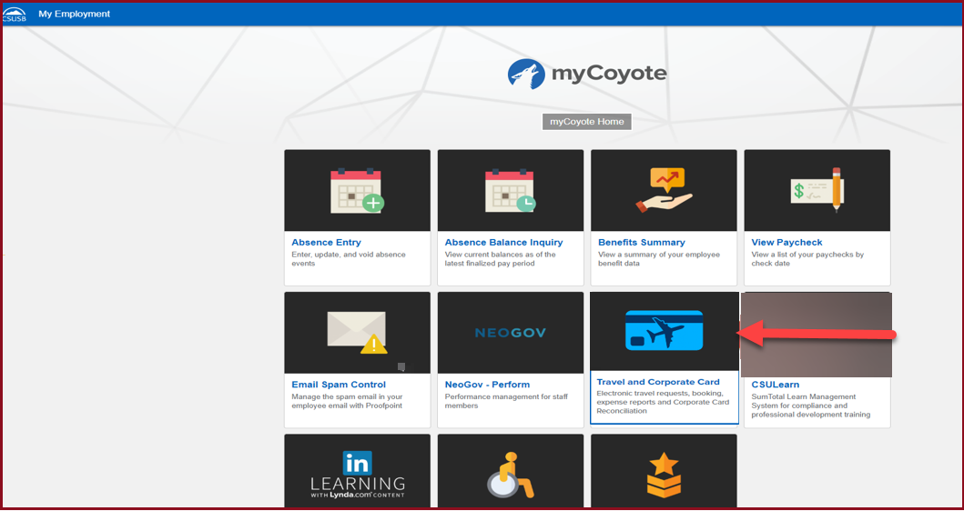
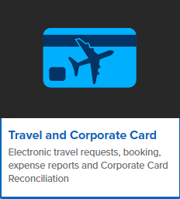
On the single sign on page, type in your mycoyote ID and password, hit enter and then either choose My Employment or, Administrative Systems and click on the Travel and Corporate card Icon as shown below:

Slide 3
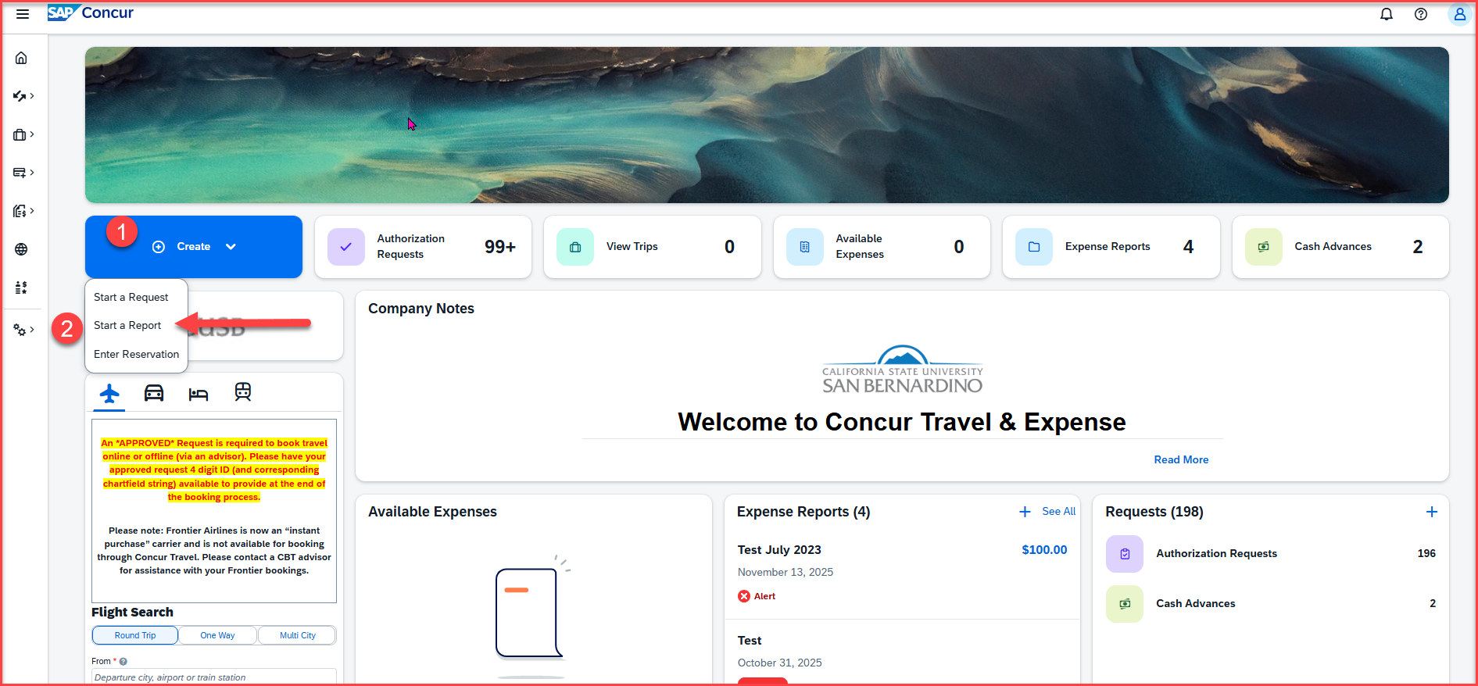
To begin the expense report, click on Create, then Start a Report

Slide 4
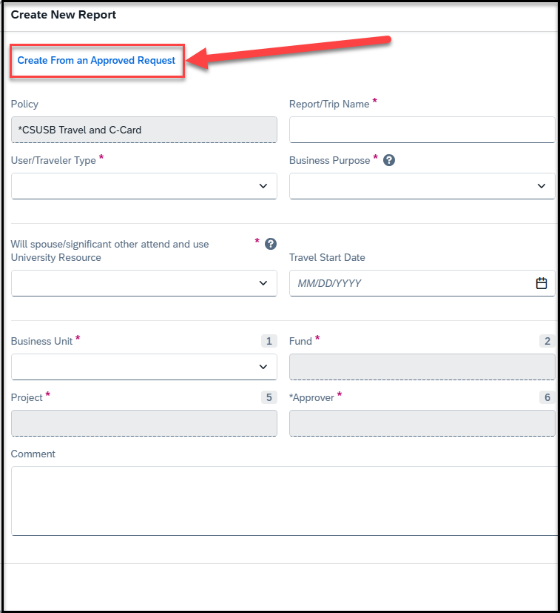
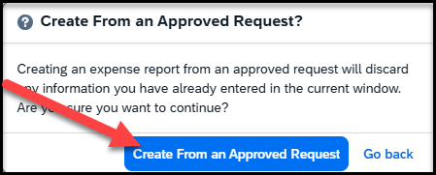
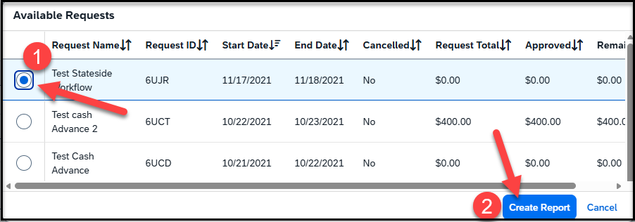
Click on Create from an Approved Request
Once you click on create from an Approved Request
-- Click on the first pop up Create From an Approved Request
--Select the Available Request and Create Report

Slide 5
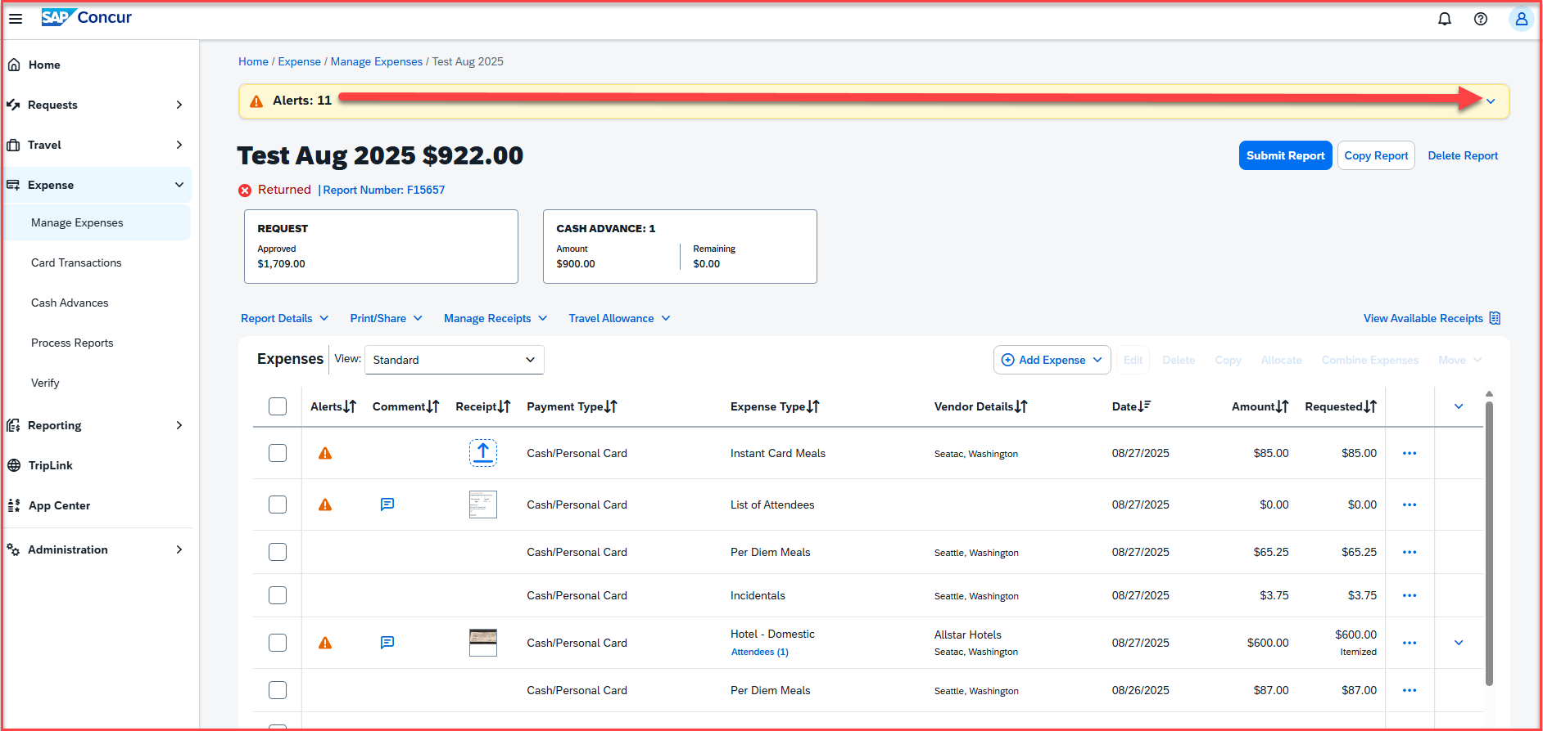
Once the report is created, there will be alerts. All the red alerts will have to be cleared. Click on the down arrow to view all the alerts

Slide 6
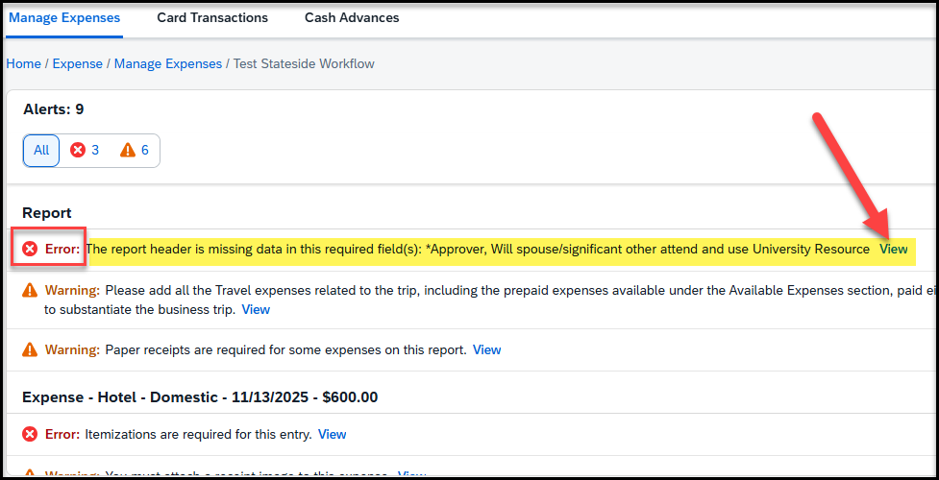
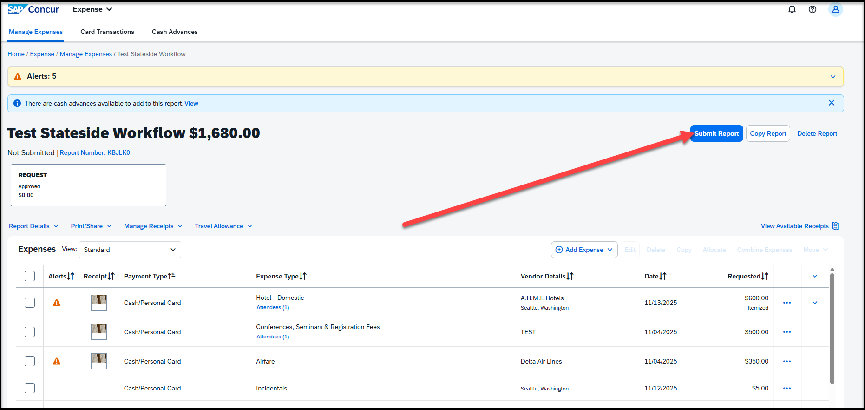
Clearing Alerts
In an expense report, there will always be an alert for missing data in the report header.
Please click on view and you will be directed to the header page, to update the missing information, including the budget approver, and hit save
All the other alerts will be either for attaching receipts, adding location for airfare, lodging etc. for expenses on the report
Since the expense report is created from your Travel Request prior to travel, you must update the actual meals for each specific days and exclude meals provided at the event. The per diem meals and incidentals will auto populate on the report, based on the travel allowance that was created on the request

Slide 7
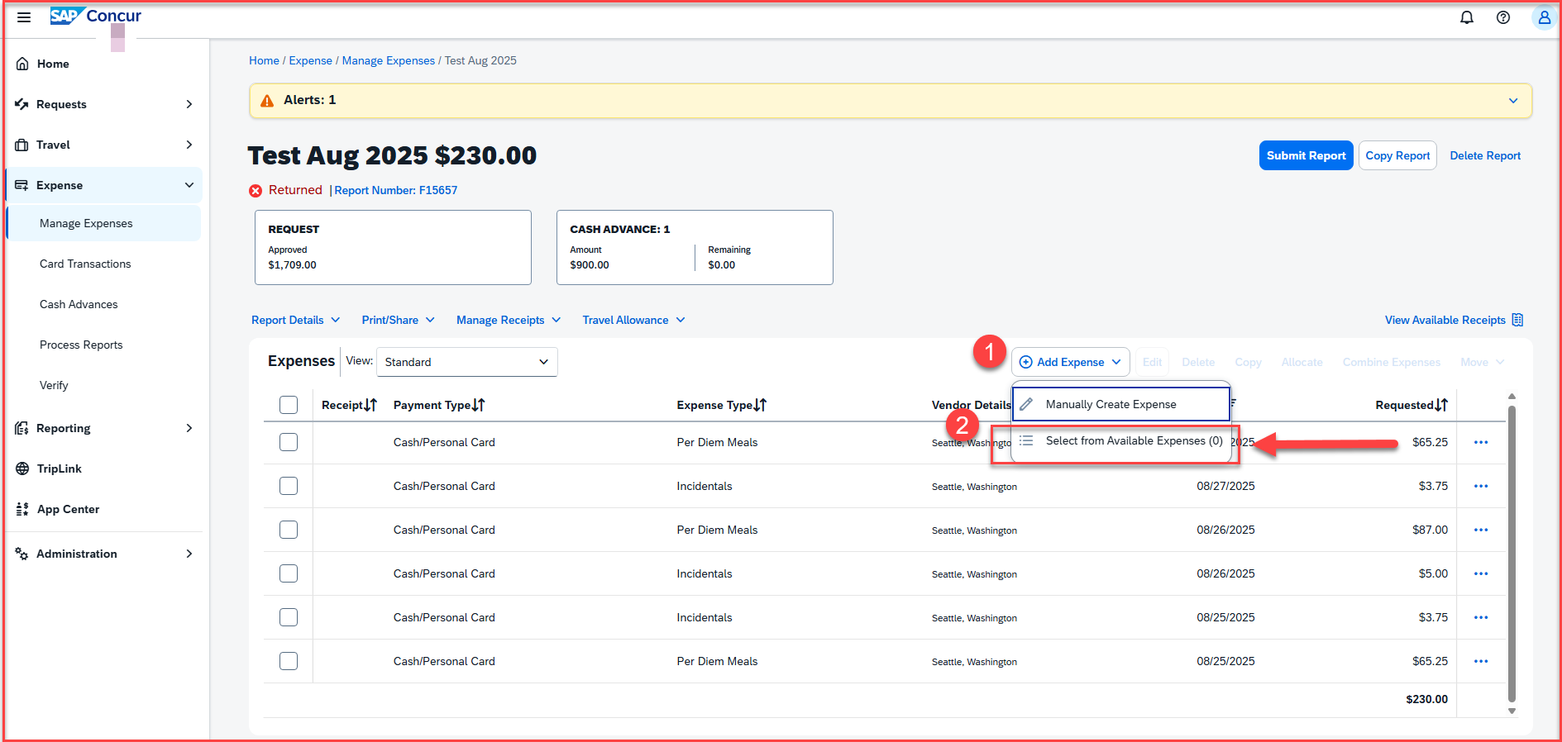
Adding Expenses: If there are prepaid expenses like airfare paid on the CSUSB Aircard, and other travel expenses like transportation etc. paid on the Corporate card, those transactions need to be imported from the Available Expenses section

Slide 8
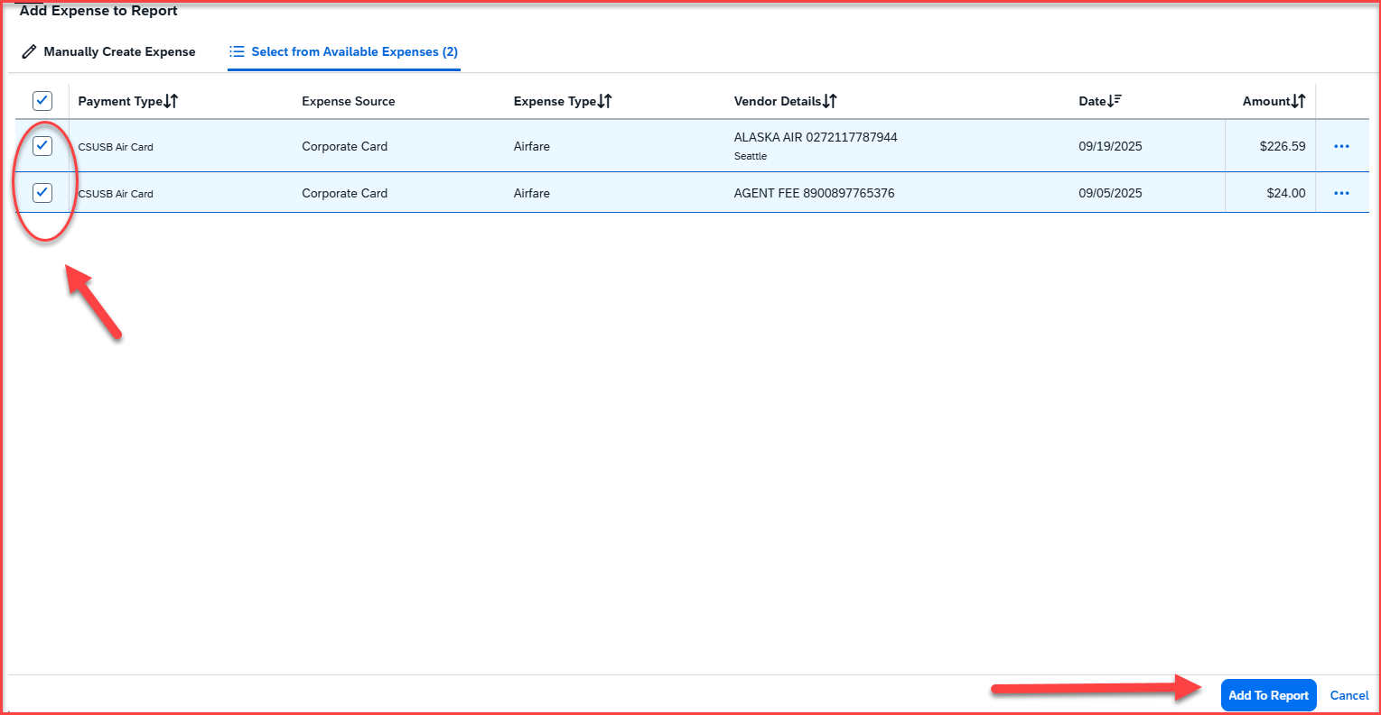
Adding Expenses: Select the Air Card expenses, and if the travel related Corporate card expenses, and click on Add To Report available on the bottom right hand corner

Slide 9
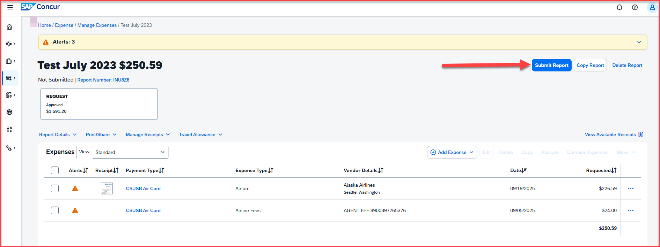
Adding Expenses : International Trips
The meals and incidentals for international trip will populate from the travel allowance that was created on the travel request
Lodging expenses for international trips is now based on actuals
The air expense paid using Concur should be imported from the Available expenses section
All other travel expenses paid using a corporate related to the trip must also be imported from the Available expenses section
A conference agenda/document/schedule is required to substantiate all business trips
Once all the expenses are added, the report is ready to be submitted, click on submit report

Slide 10
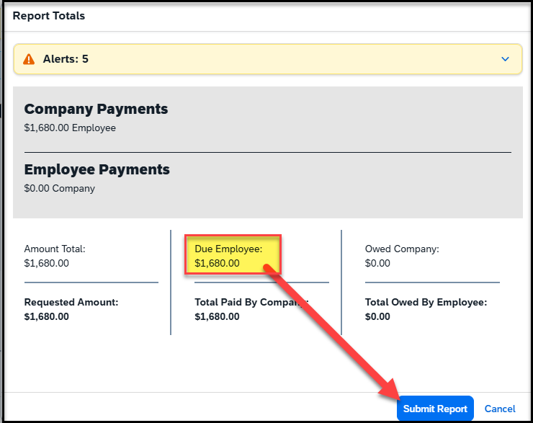
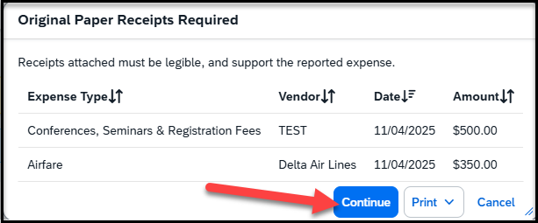
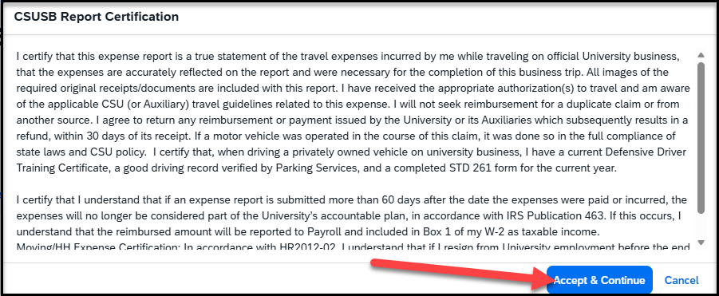
Once you click on Submit Report, the following screens will appear
This screen will show a breakdown of the report totals - Due Employee is the actual amount of reimbursement to the payee. Click on Submit Report
This screen shows that Original Paper Receipts are required, and then click on Continue
The CSUSB Report Certification page appears, click on accept & continue

Slide 11
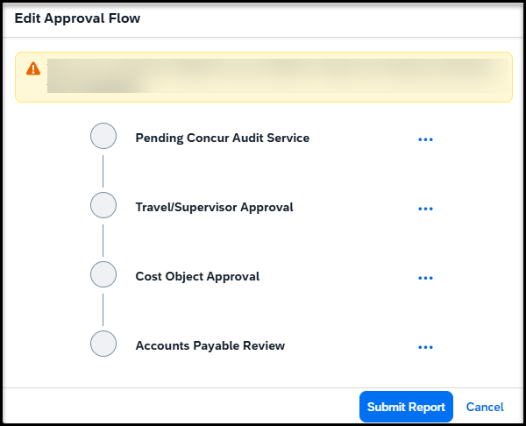
Once you click on continue, the approval Flow will appear
Concur Audit Service – known as Verify, is an AI tool that checks for checks for compliance issues, errors, and policy violations.
Travel/Supervisor Approval – This is the reports to/manager of the employee and will populate the name
Cost object Approval – This is the budget approver of the department. The name will be hidden behind the scenes, but it is the approver that was added to the header
Accounts Payable Review – This is the Accounts Payable department. All expense reports are reviewed and approved by accounts payable as the last approver

Slide 12
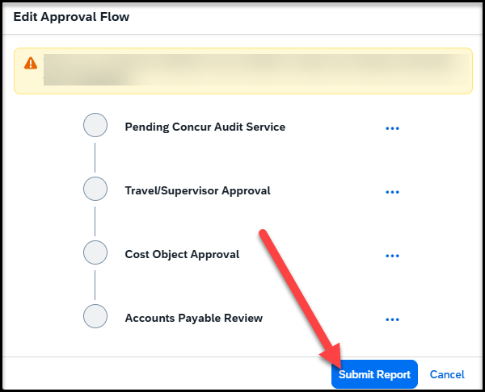
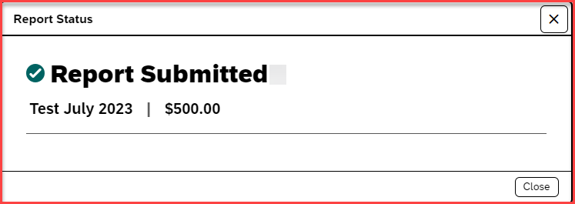
Once the Approval flow is reviewed, click on Submit Report – A pop-up will appear as Report submitted

Slide 13
THANK YOU!
If further information or assistance is needed, please do not hesitate to contact Accounts Payable/Travel at travel@csusb.edu or 909-537-5155.
Notes:
Updated August, 2017 CL

