Slide 1
Create a travel request with Cash Advance

Slide 2
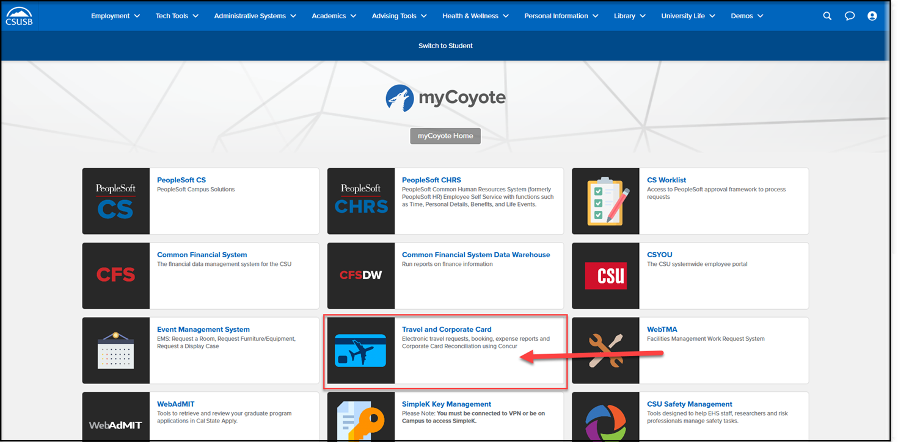
On the single sign on page, type in your mycoyote ID and password, hit enter and then either choose My Employment or Administrative Systems and click on the Travel and Corporate card Icon as shown below:

Slide 3
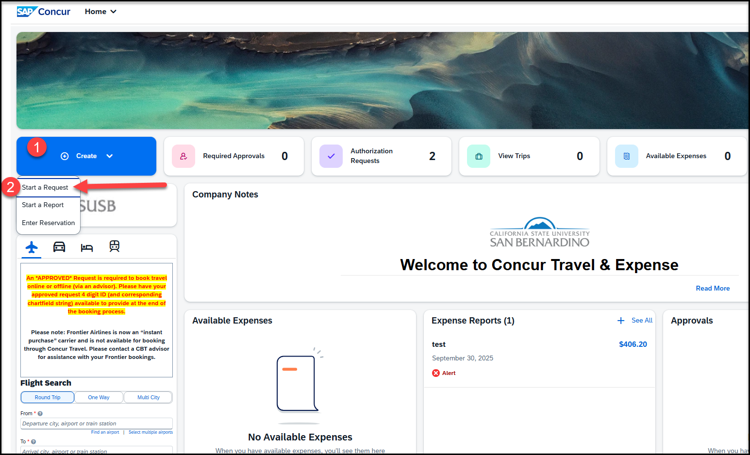
To begin a Travel Request, click on Create, then Start a Request
Notes:
This page is your home page
Go over all information on this page

Slide 4
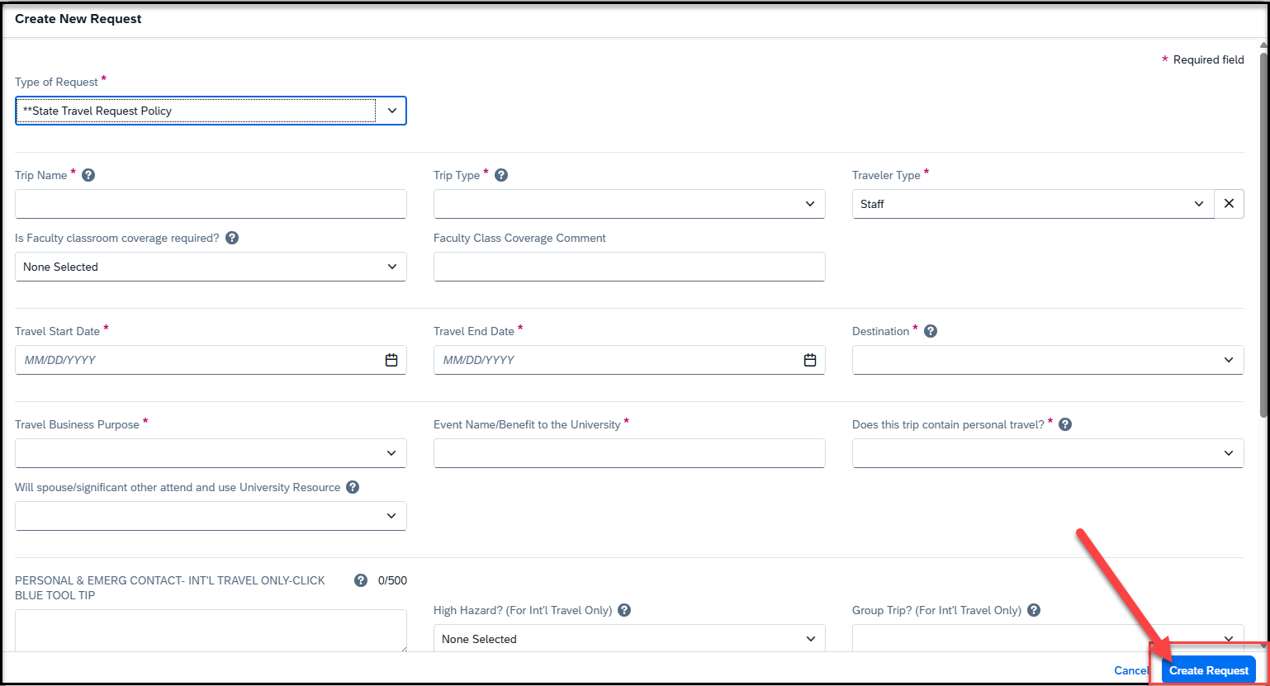
Input your travel information on the Request Header. Each required text box is noted by an asterisk on the top of the box. Use the down arrows and the calendar when available on each box. After entering all the required information click on Create Request
The approver on the header is the budget approver of your department
Please note that If you are not aware of the approver name, reach out to your department

Slide 5
Request Header Components
Type of Request – This is the funding source of your trip, either it can be State Policy or Auxiliary Policy
Trip Name Please add a meaningful name based on your business trip
Trip Type For Travel within state - choose instate, outside the state - out of state, and out of the country - international
Traveler Type Group Travel – trips sponsored by staff/faculty consisting a group of students, Team Travel – Athletics Team trips
Travel Business Purpose Please choose the appropriate business purpose related to the trip
Event Name/Benefit to the University This can be the same as the Trip Name
Does this trip contain personal travel Answer Yes or, No . If answer is Yes, attach the comparison price to the Request
Personal & Emerg Contact/High Hazard/Group Trip Required to fill the 3 boxes, if the trip is international
Chart Field String Information If you are unaware of the account numbers, contact your department
Business Unit – Type the business unit in the box, and select from the dropdown list that appears below
Fund – Type the fund in the box, and select from the dropdown list that appears below
Department – Type the department in the box, and select from the dropdown list that appears below
Program – The program code is NONE. Please type NONE and select from the dropdown list that appears below
Project – Type the project code in the box and select from the dropdown list that appears. If there is no project code, select NONE.
Approver – Choose the budget approver of your department from the list that appears in the box
Class Code – Change the drop-down option from Text to Either to search by Text or Code. Type the class code, if you have one and select from the dropdown list

Slide 6
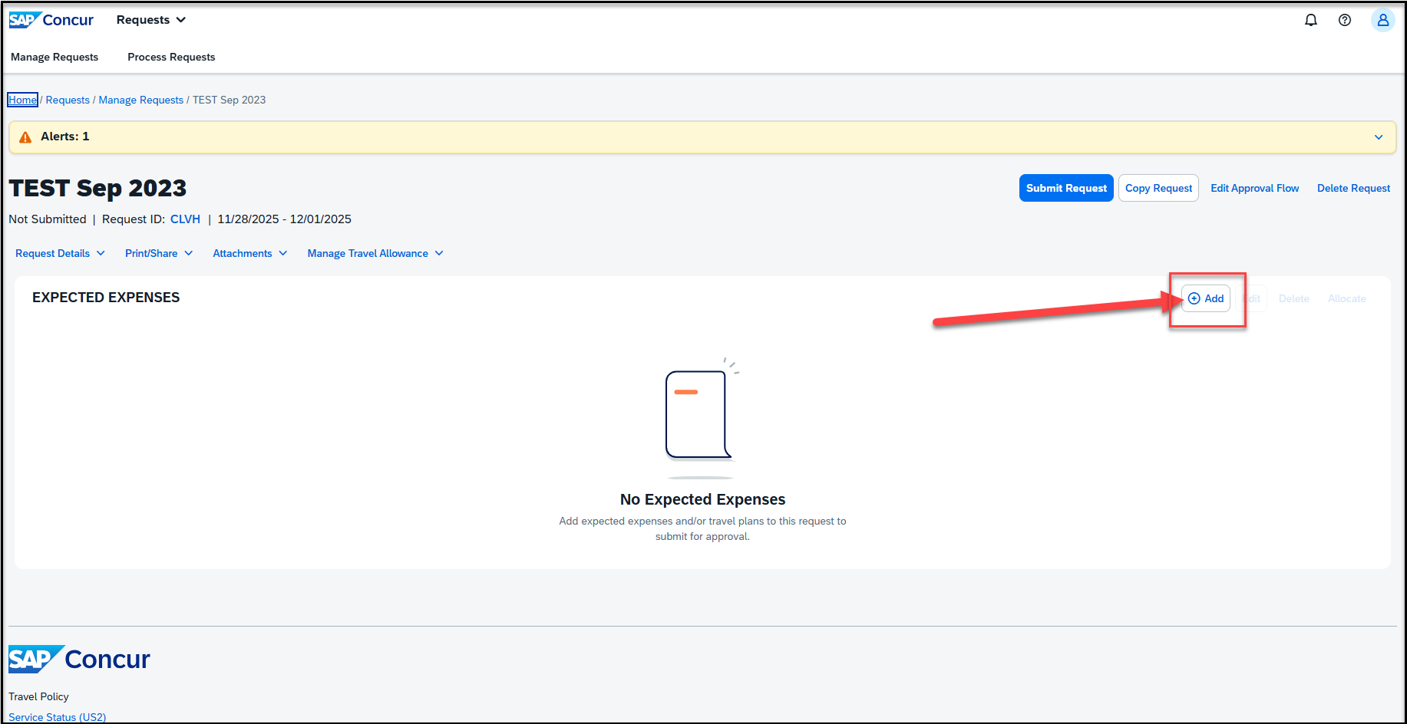
Adding Expenses- Click on Add and scroll down to add all the estimated Travel expenses for the trip

Slide 7
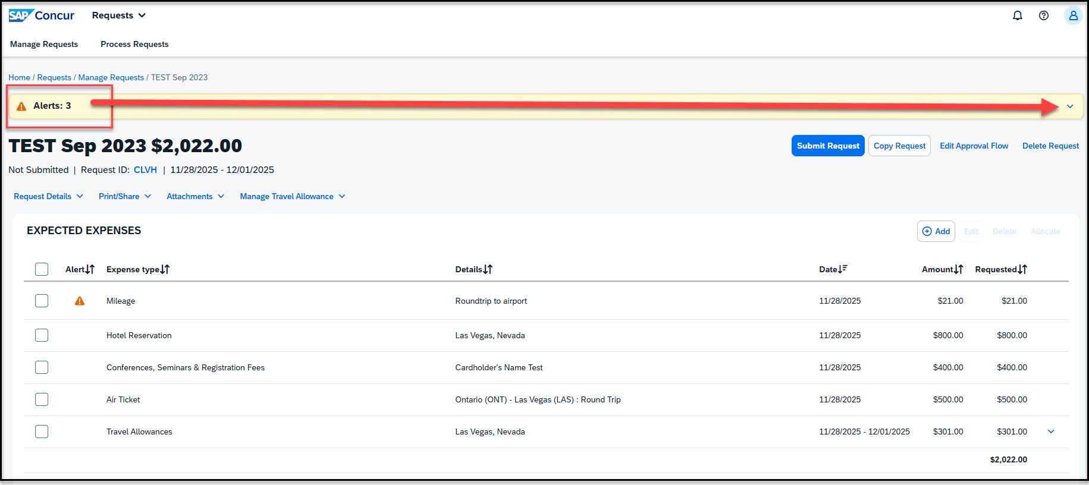
Alerts: Alerts with the red exclamation ! needs to be cleared. The Warning (triangle) alerts are notifications and won't restrict from submitting the Request. Click on the down arrow to expand and view all of the alerts.

Slide 8
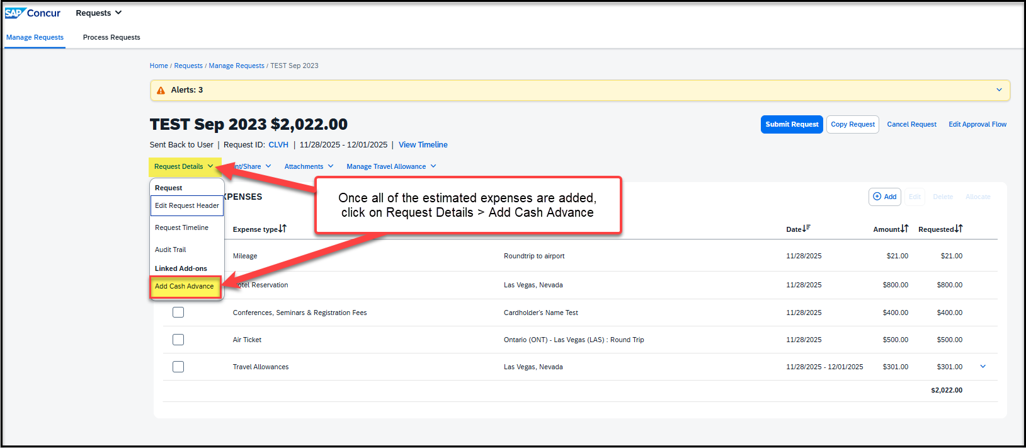
Once all the estimated expenses are entered, click on Request Details > Add Cash Advance

Slide 9
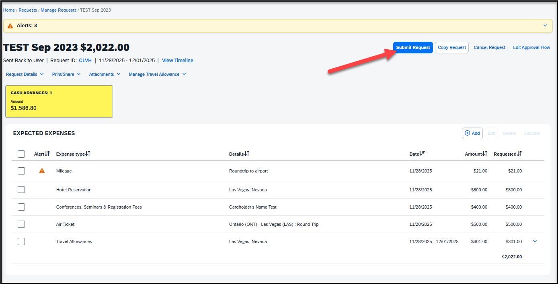
As you enter your estimated expenses, make sure to save after each entry. Once all expenses have been entered, a summary will appear in the top-left corner, and the Estimated Total will display in the bottom-right corner. The cash advance amount will automatically calculate and display on the request page. When everything looks correct, submit your request.

Slide 10
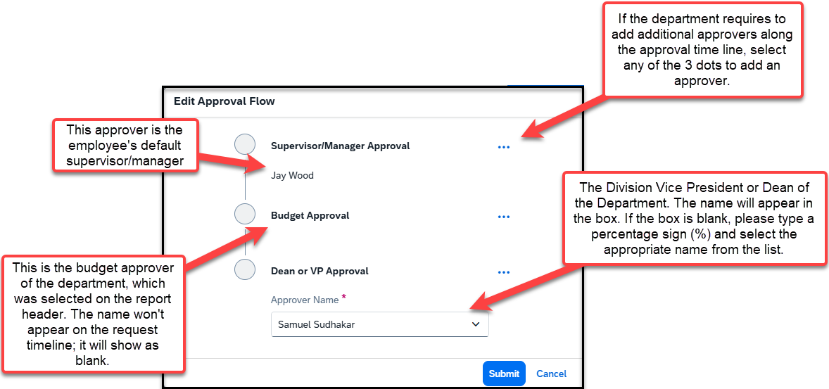
Travel Request Workflow Steps:
Approval Flow is now called Request Timeline
Please note: each approver has 9 days to approve a Request. If they don’t approve within this timeframe, the Request will time out, and the user will have to resubmit the Request

Slide 11
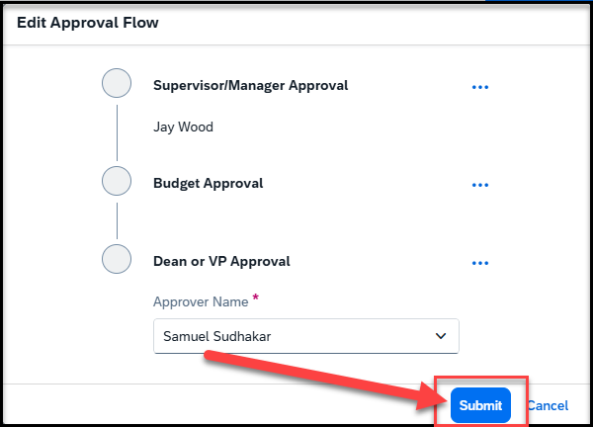
Click on Submit.

Slide 12
THANK YOU!
If further information or assistance is needed, please do not hesitate to contact Accounts Payable/Travel at travel@csusb.edu or 909-537-5155.
Notes:
Updated August, 2017 CL

