Slide 1
How to create Travel meal allowance & incidentals

Slide 2
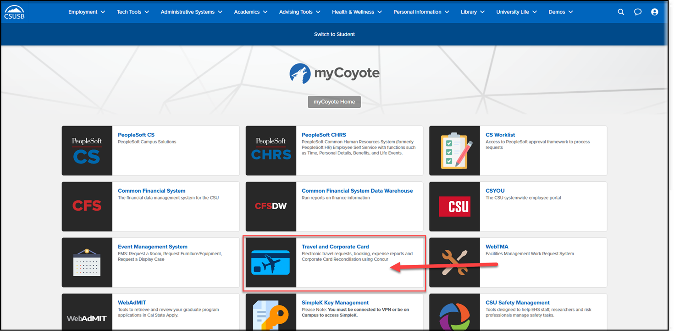
On the single sign on page, type in your mycoyote ID and password, hit enter and then either choose My Employment or, Administrative Systems and click on the Travel and Corporate card Icon as shown below:

Slide 3
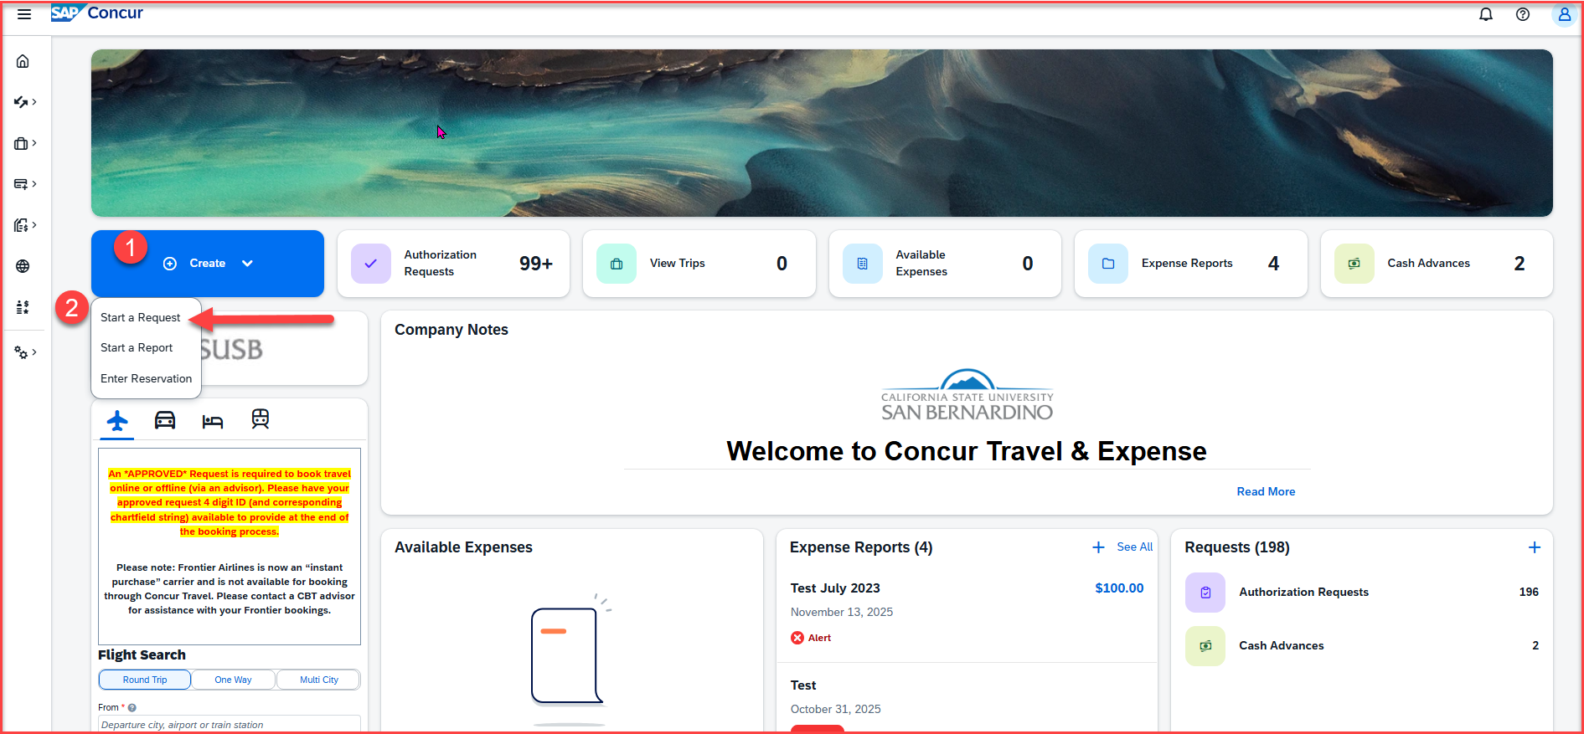
To begin a Travel Request, click on Create, then Start a Request
Notes:
This page is your home page
Go over all information on this page

Slide 4
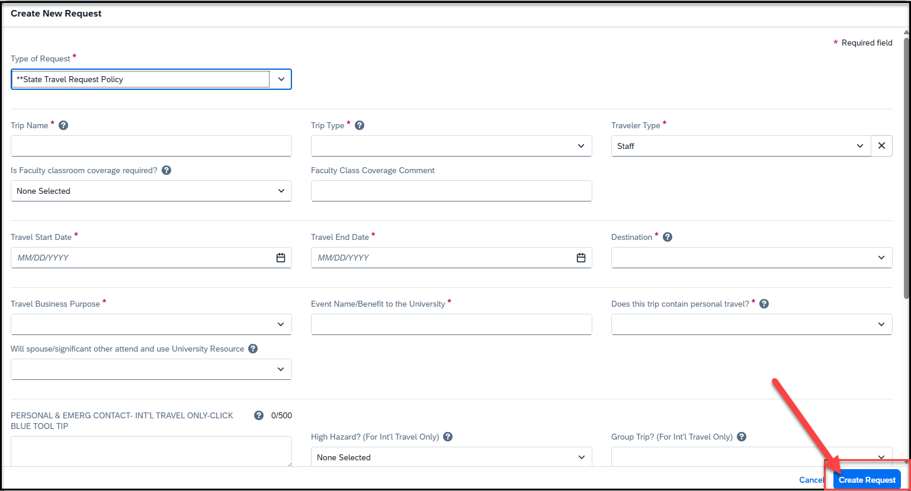
Input your travel information on the Request Header. Each required text box is noted by an asterisk on the top of the box. Use the down arrows and the calendar when available on each box. After entering all the required information click on Create Request
The approver on the header is the budget approver of your department
Please note that If you are not aware of the approver name, reach out to your department

Slide 5
Request Header Components
Type of Request – This is the funding source of your trip, either it can be State Policy or Auxiliary Policy
Trip Name Please add a meaningful name based on your business trip
Trip Type For Travel within state - choose instate, outside the state - out of state, and out of the country - international
Traveler Type Group Travel – trips sponsored by staff/faculty consisting a group of students, Team Travel – Athletics Team trips
Travel Business Purpose Please choose the appropriate business purpose related to the trip
Event Name/Benefit to the University This can be the same as the Trip Name
Does this trip contain personal travel Answer Yes or No . If answer is Yes, attach the comparison price to the Request
Personal & Emerg Contact/High Hazard/Group Trip Required to fill the 3 boxes, if the trip is international
Chart Field String Information If you are unaware of the account numbers, contact your department
Business Unit – Type the business unit in the box, and select from the dropdown list that appears below
Fund – Type the fund in the box, and select from the dropdown list that appears below
Department – Type the department in the box, and select from the dropdown list that appears below
Program – The program code is NONE. Please type NONE and select from the dropdown list that appears below
Project – Type the project code in the box and select from the dropdown list that appears. If there is no project code, select NONE.
Approver – Choose the budget approver of your department from the list that appears in the box
Class Code – Change the drop-down option from Text to Either to search by Text or Code. Type the class code, if you have one and select from the dropdown list

Slide 6
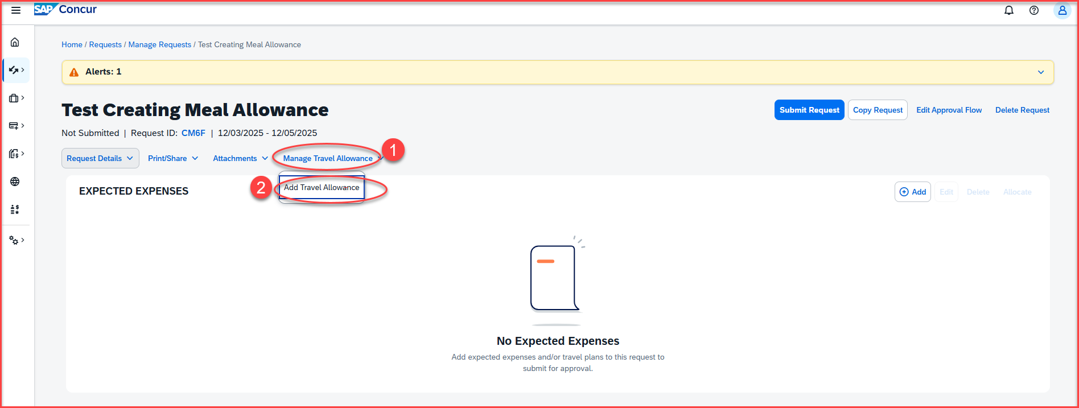
Adding Travel Allowance - Click on Manage Travel Allowance and then Add Travel Allowance

Slide 7
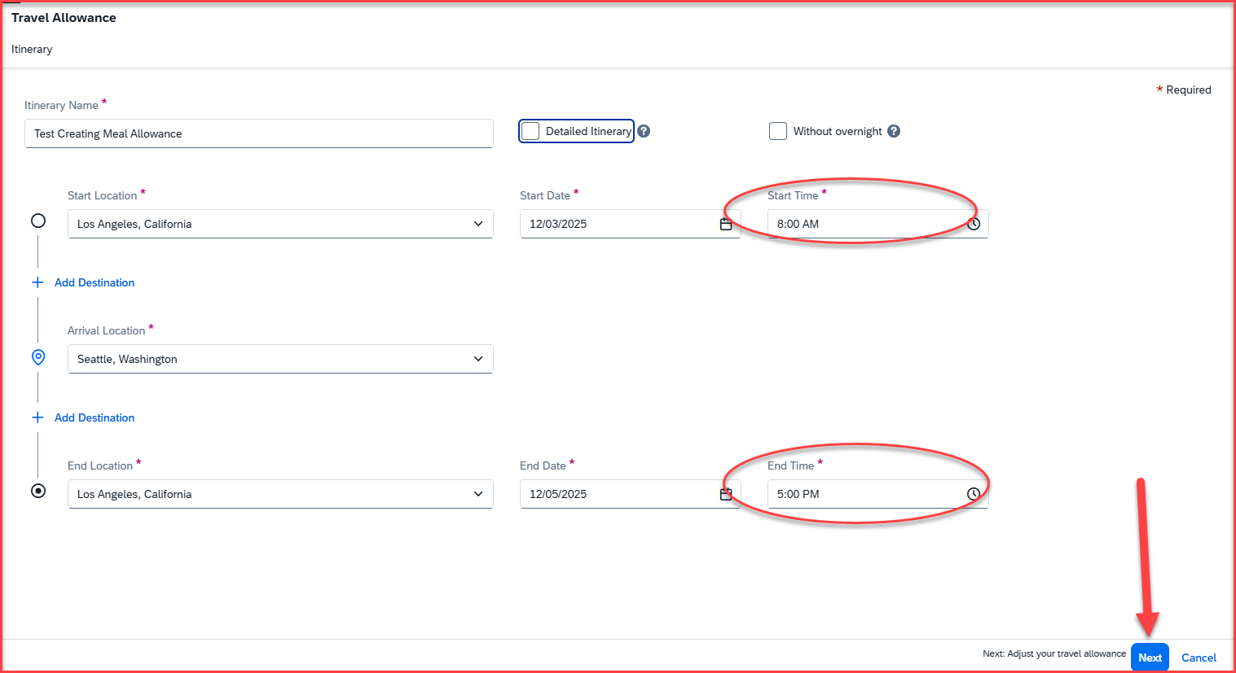
Adding Travel Allowance – Once you click on add travel allowance, the following screen will appear
The start location and start time will prepopulate from the request header information of the trip
The start time and end time will have to be added
Once the start time and end time is added, click on next on the right-side bottom corner

Slide 8
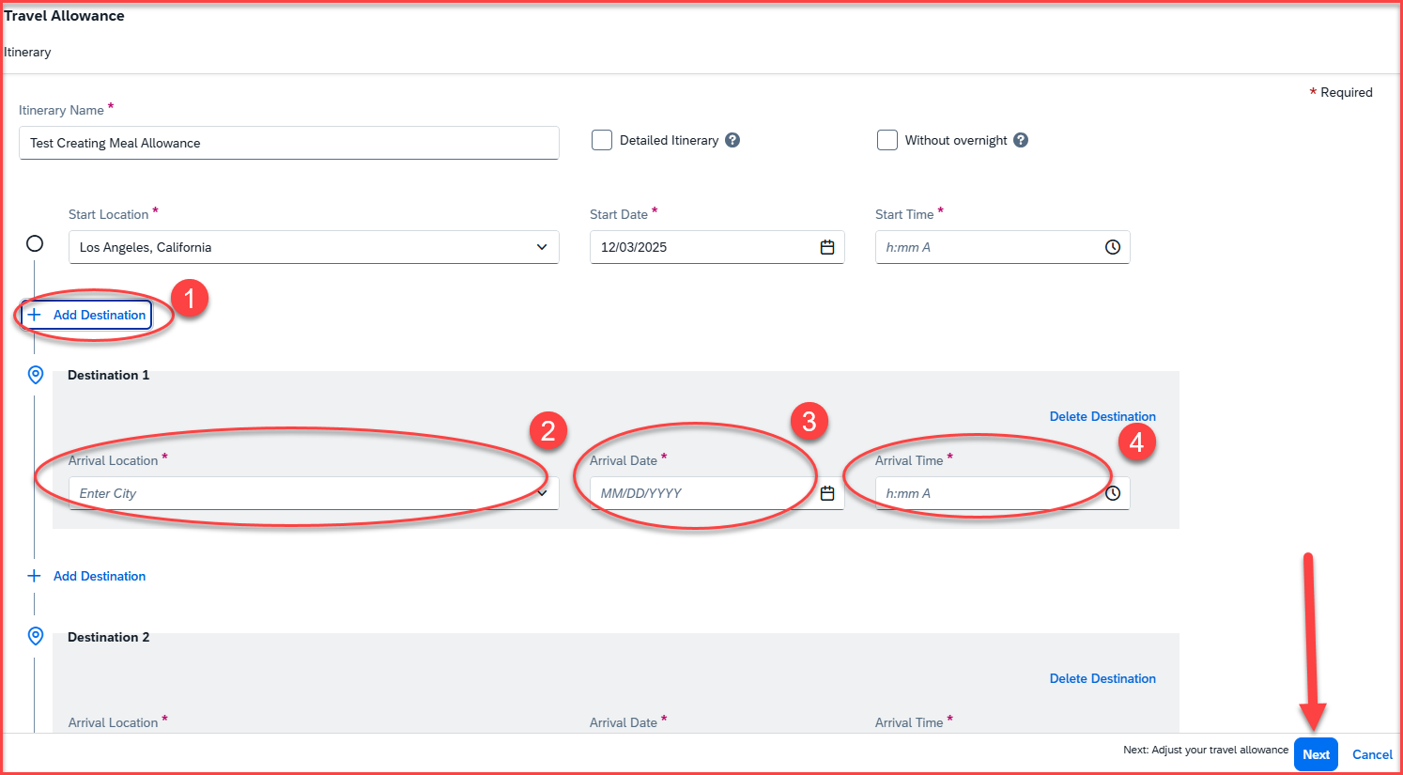
Adding Multiple Destinations
For adding multiple destinations, click on +Add Destination
Add arrival location, arrival date and arrival time
Once all the destinations are added, click on next, available at the right-side bottom corner

Slide 9
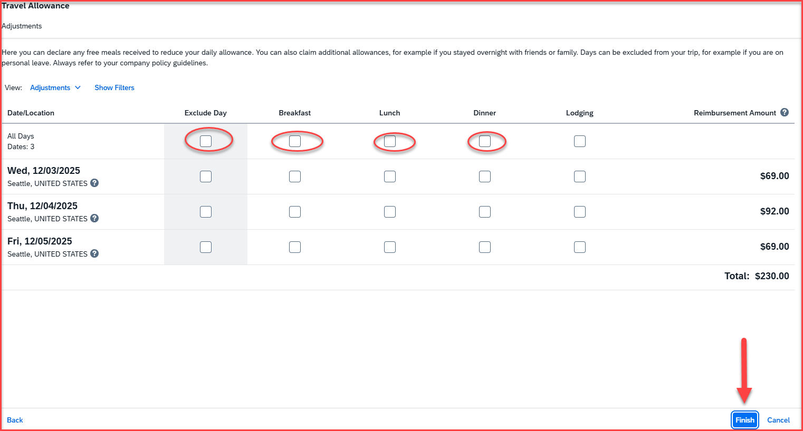
Adding Travel Allowance – The following screen will appear once you click on next
If meals like breakfast, lunch or dinner are included in the conference/meeting, you must click on the boxes to exclude the meal allowance and the incidentals
If meals need to be excluded for the whole day, check mark the box under the Exclude Day
The amounts will be recalculated under the reimbursement amount section
Please note that the first and last day of meals and incidentals is calculated at 75%
Once all that is updated, click on Finish available at the right-side bottom corner

Slide 10
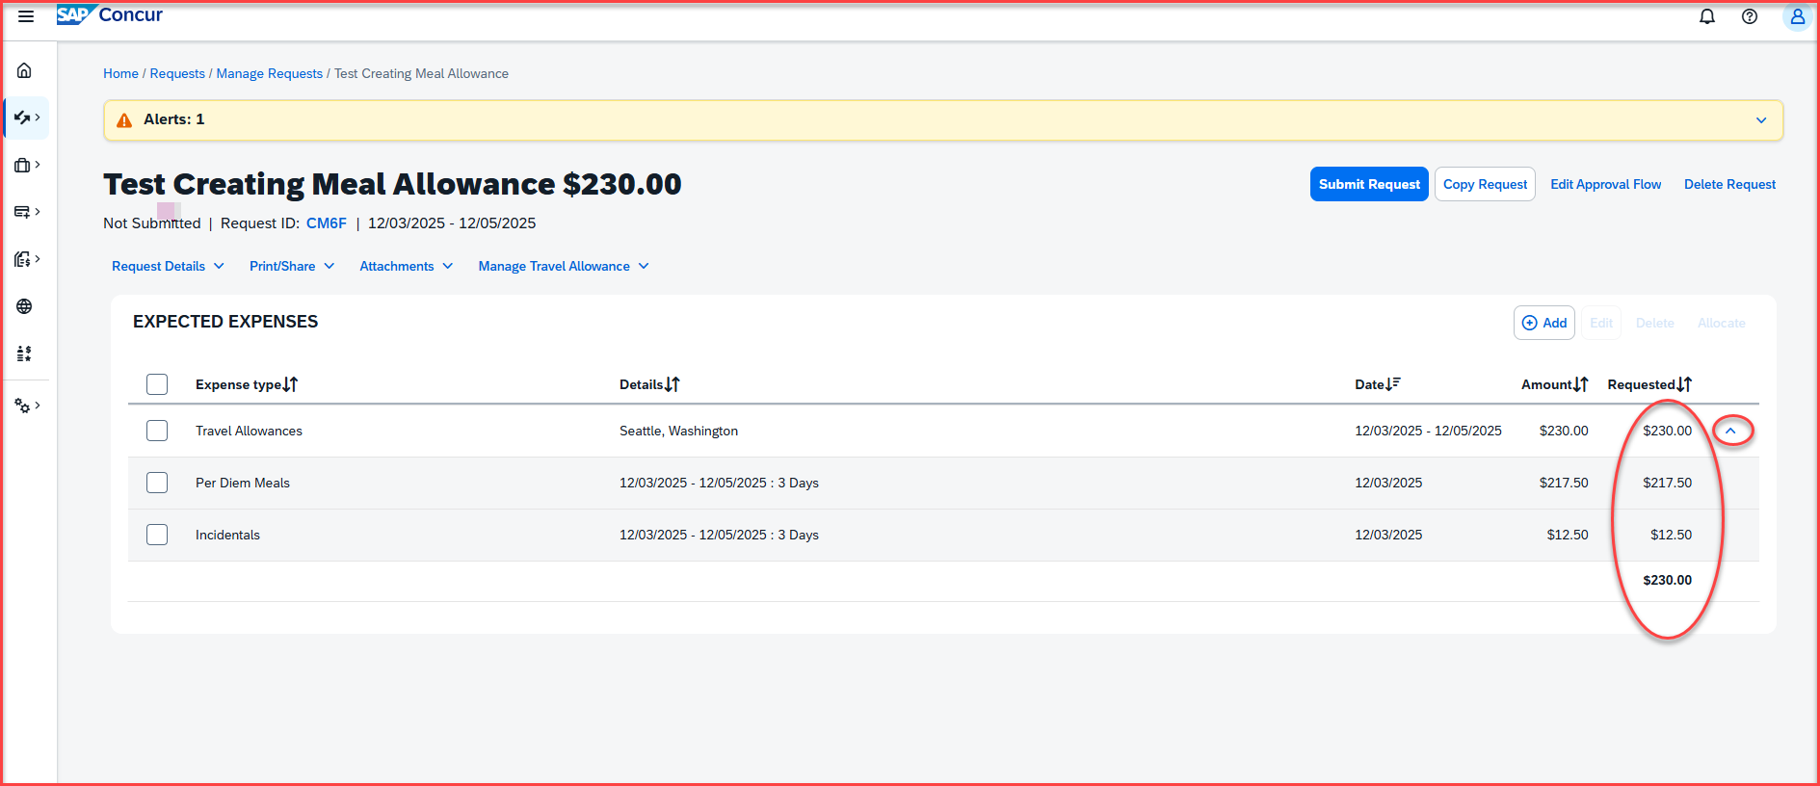
Adding Travel Allowance – Once you click on Finish, the following screen will appear.
The travel allowance and the incidental amount will be under the Requested section on the far right. Click on the down arow to expand the expense lines. The per diem amount and the incidentals will be for the total of the number of days of the trip

Slide 11
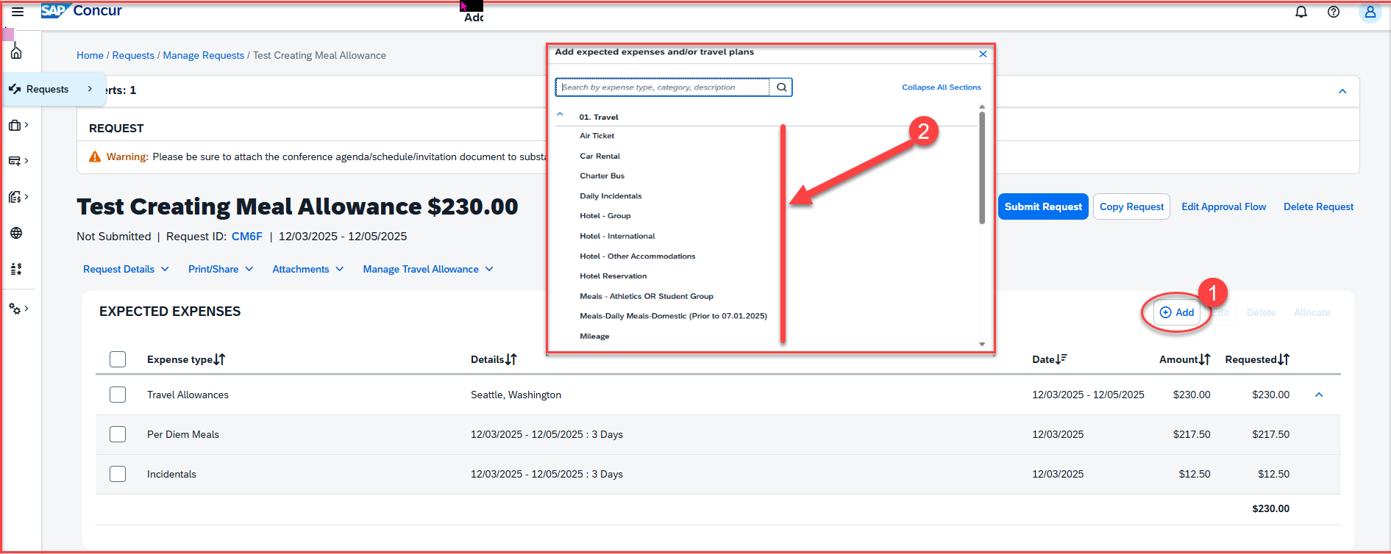
Adding Estimated Expenses: Once the travel meal allowance and incidentals are added, add the remaining estimated expenses
Click on +Add, then add the remaining estimated travel expenses from the dropdown list.

Slide 12
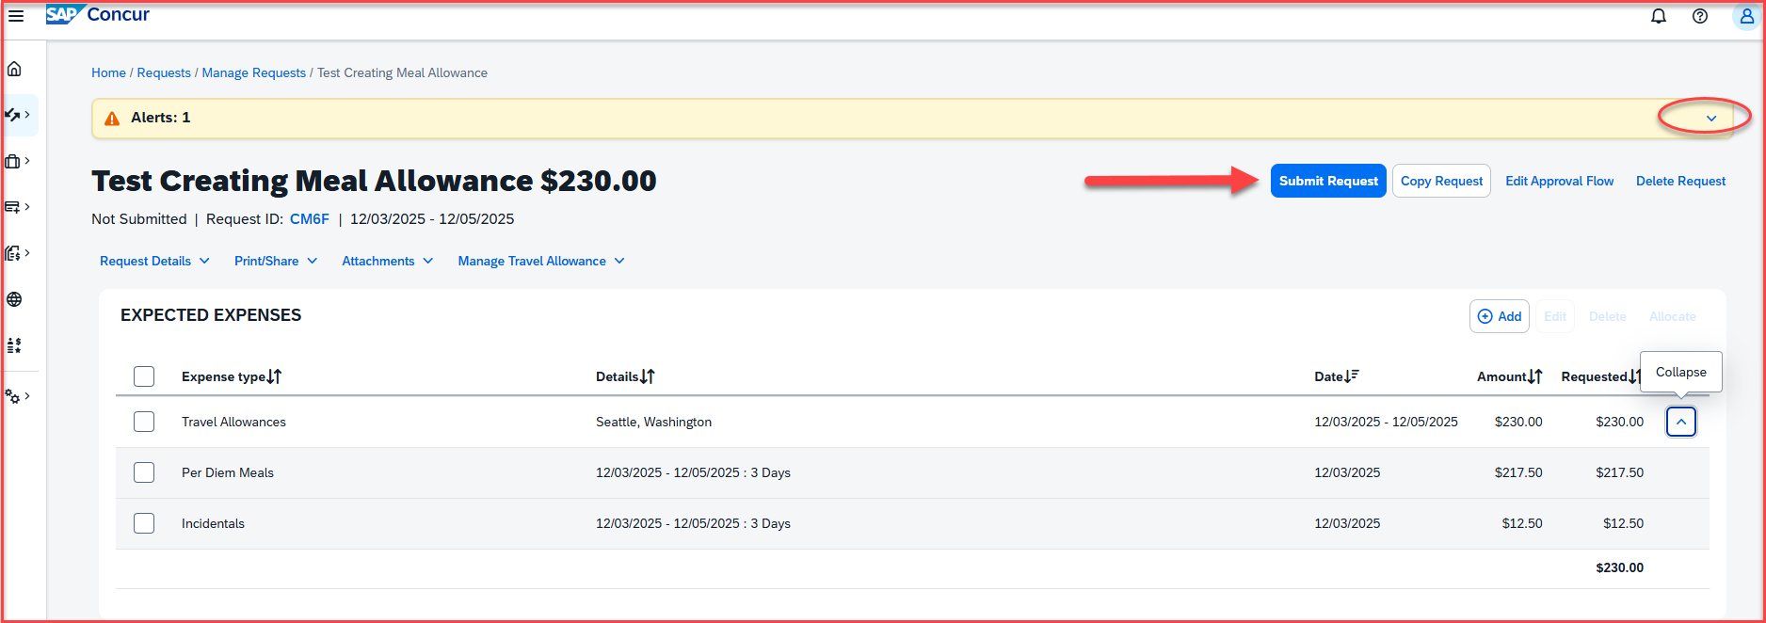
Alerts: Alerts with the red exclamation ! needs to be cleared. The Warning (triangle) alerts are notifications and won't restrict from submitting the Request. Click on the down arrow to expand and view all the alerts. Once all the expenses are added, click on submit request, available at the right-side corner
Adding Travel Allowance - Click on Manage Travel Allowance and then Add Travel Allowance

Slide 13
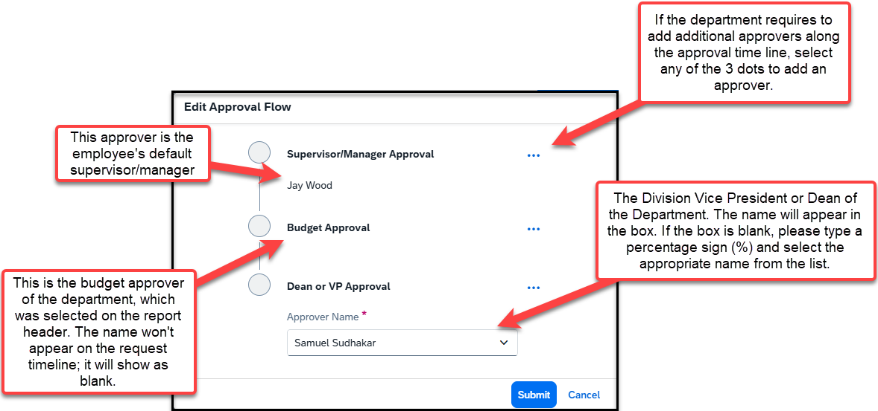
Travel Request Workflow Steps: The approval flow will come up after you click on submit request. Approval Flow is now called Request Timeline
Please note: each approver has 9 days to approve a Request. If they don’t approve within this timeframe, the Request will time out, and the user will have to resubmit the Request

Slide 14
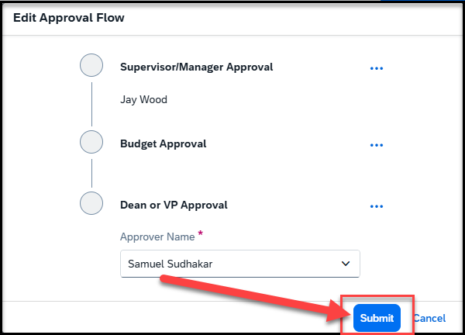
Click on Submit.

Slide 15
THANK YOU!
If further information or assistance is needed, please do not hesitate to contact Accounts Payable/Travel at travel@csusb.edu or 909-537-5155.
Notes:
Updated August, 2017 CL

