Slide 1
How to Create an international travel request

Slide 2
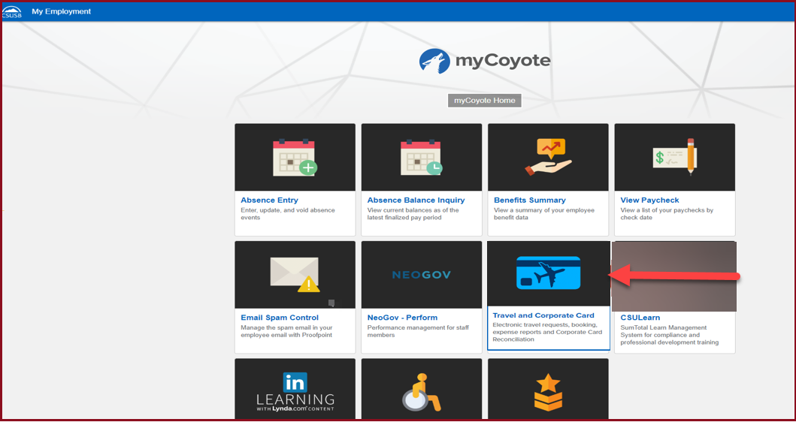
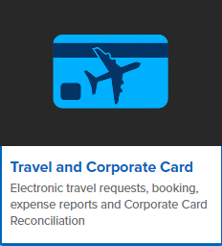
On the single sign on page, type in your mycoyote ID and password, hit enter and then either choose My Employment or, Administrative Systems and click on the Travel and Corporate card Icon as shown below:

Slide 3
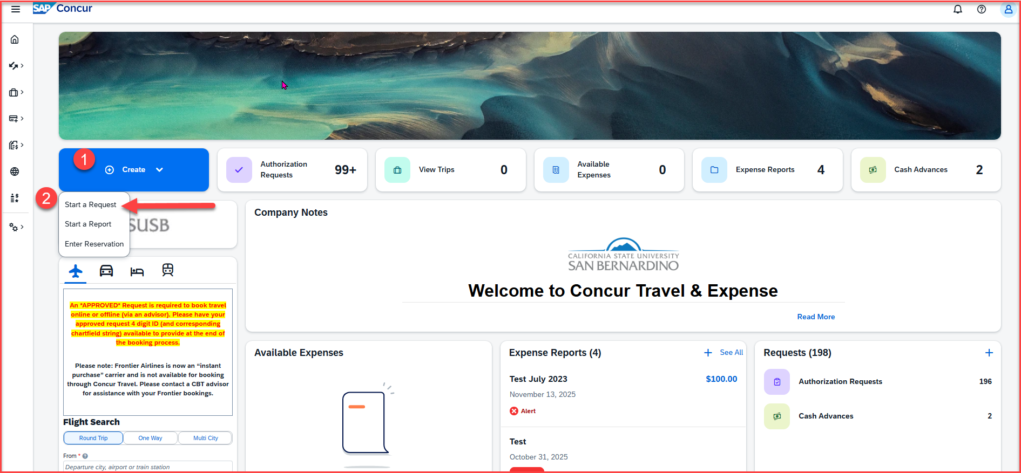
To begin a Travel Request, click on Create, then Start a Request
Notes:
This page is your home page
Go over all information on this page

Slide 4
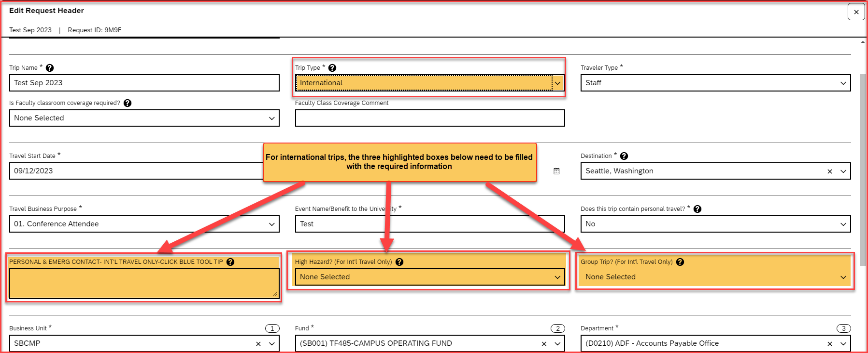
Input your travel information on the Request Header. For International trips, the Trip Type should be Travel International, and the 3 boxes needs to be filled with the personal & emergency contact, High Hazard and Group Trip information. After entering all the required information click on Create Request
The approver on the header is the budget approver of your department. If you are not aware of the approver name, please reach out to your department
The 3 highlighted boxes on the screenshot needs to be filled with the required information

Slide 5
Request Header Components – International Travel
For all international trips: It is required to fill in the Personal & Emerg Contact/High Hazard/Group Trip
Type of Request – This is the funding source of your trip, either it can be State Policy or Auxiliary Policy
Trip Name Please add a meaningful name based on your business trip
Trip Type For Travel out of the country - Travel international
Traveler Type Group Travel – trips sponsored by staff/faculty consisting a group of students, Team Travel – Athletics Team trips
Travel Business Purpose Please choose the appropriate business purpose related to the trip
Event Name/Benefit to the University This can be the same as the Trip Name
Does this trip contain personal travel Answer Yes or No . If answer is Yes, attach the comparison price to the Request
Personal & Emerg Contact/High Hazard/Group Trip Required to fill the 3 boxes, if the trip is international
Chart Field String Information If you are unaware of the account numbers, contact your department
Business Unit – Type the business unit in the box, and select from the dropdown list that appears below
Fund – Type the fund in the box, and select from the dropdown list that appears below
Department – Type the department in the box, and select from the dropdown list that appears below
Program – The program code is NONE. Please type NONE and select from the dropdown list that appears below
Project – Type the project code in the box and select from the dropdown list that appears. If there is no project code, select NONE.
Approver – Choose the budget approver of your department from the list that appears in the box
Class Code – Change the drop-down option from Text to Either to search by Text or Code. Type the class code, if you have one and select from the dropdown list

Slide 6
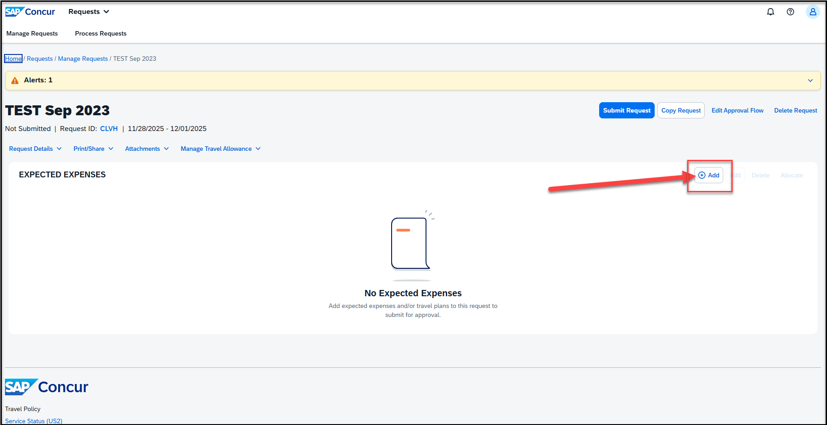
Adding Expenses- Click on Add and scroll down to add all the estimated Travel expenses for the trip

Slide 7
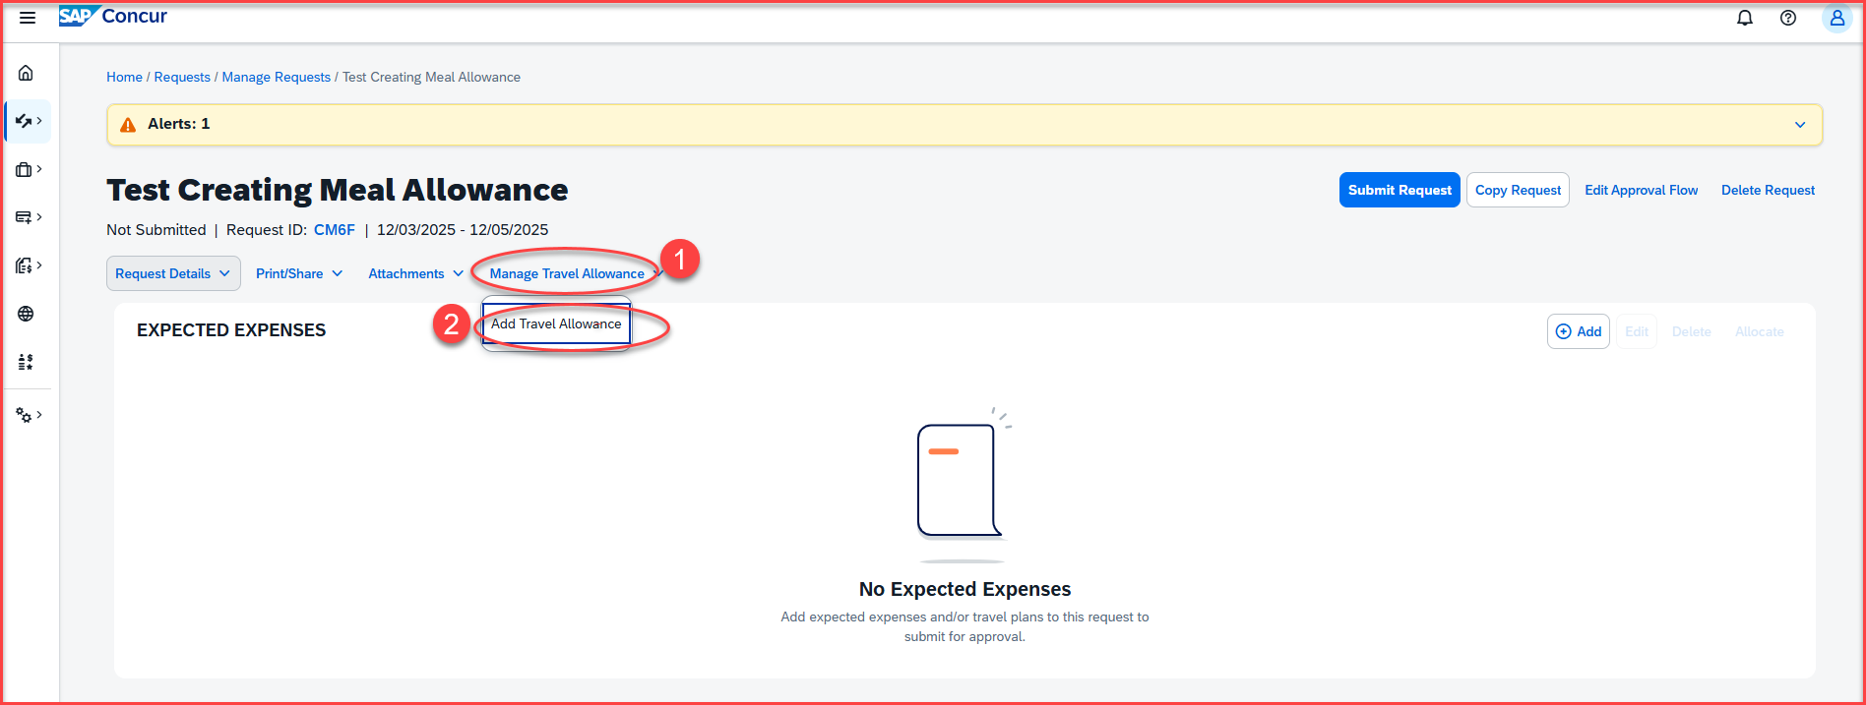
Adding Meal Allowance For International Trips - Click on Manage Travel Allowance and then Add Travel Allowance

Slide 8
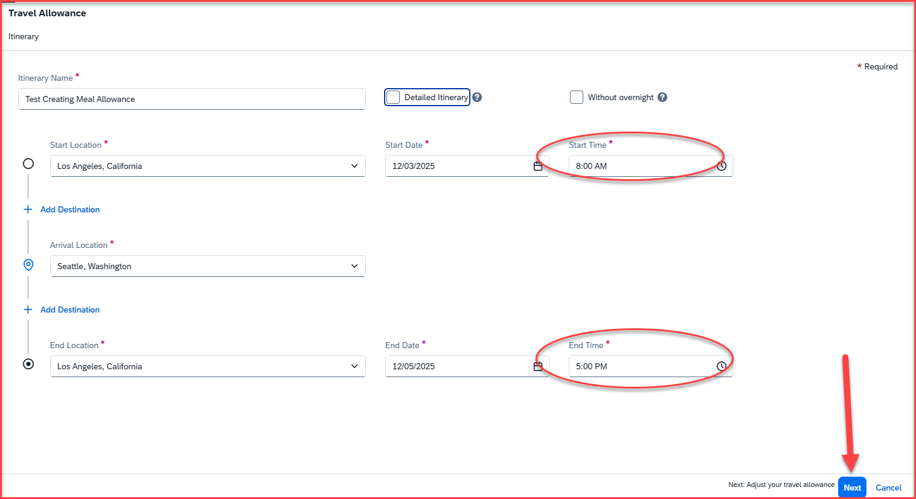
Once you click on add travel allowance, the following screen will appear
The start location and start time will prepopulate from the request header information of the trip
The start time and end time will have to be added
Once the start time and end time is added, click on next on the right-side bottom corner

Slide 9
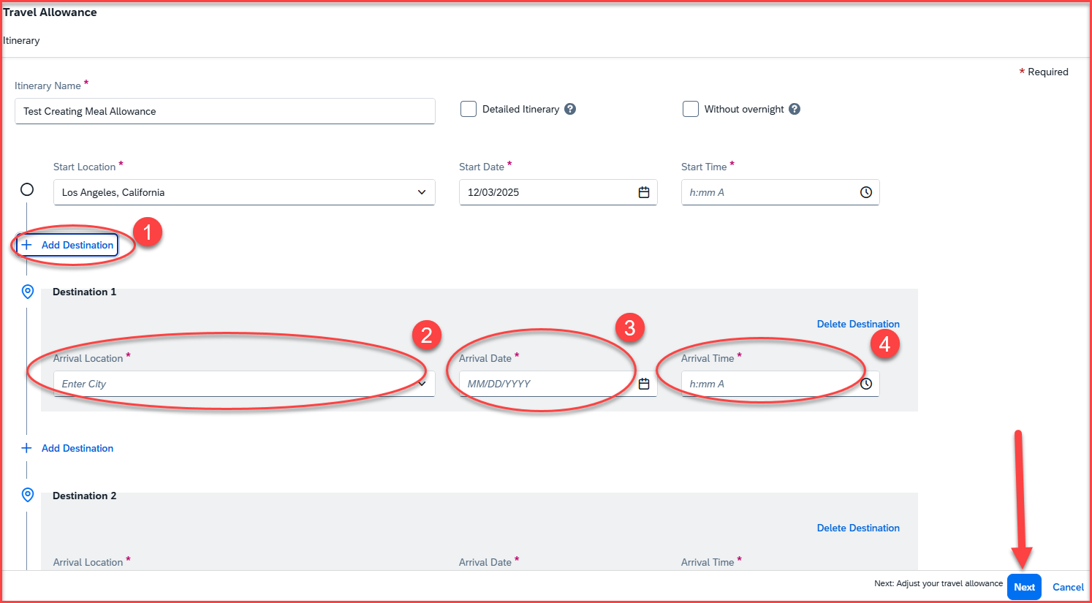
Adding Multiple Destinations
For adding multiple destinations, click on +Add Destination
Add arrival location, arrival date and arrival time
Once all the destinations are added, click on next, available at the right-side bottom corner

Slide 10
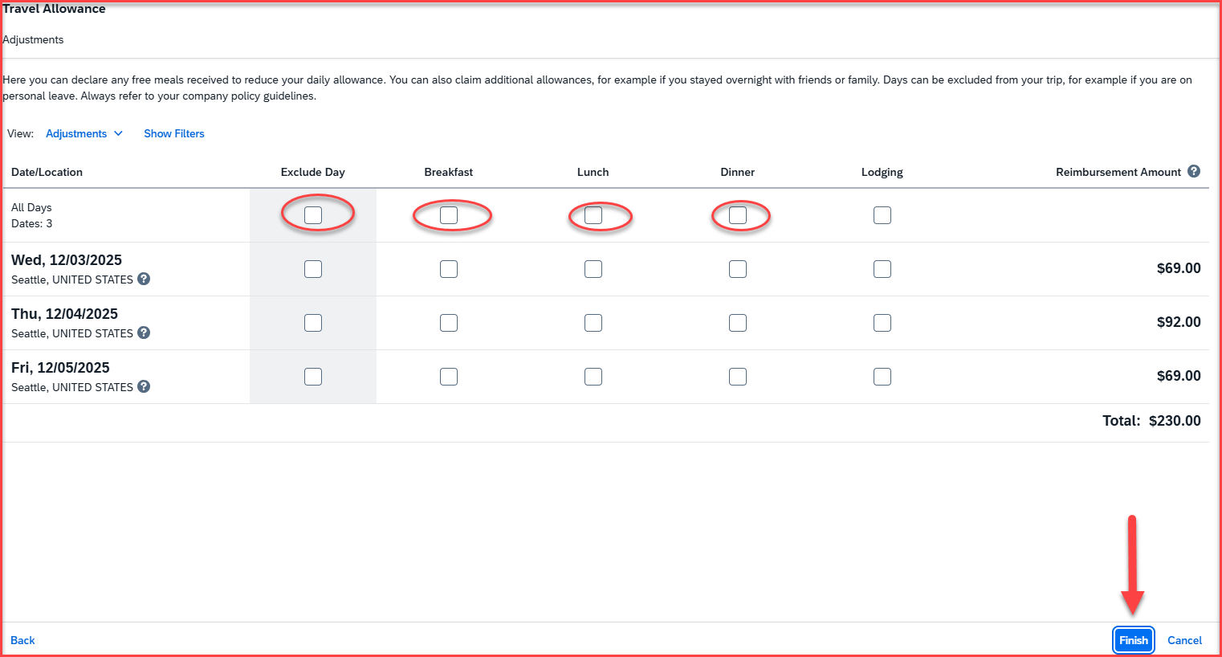
The following screen will appear once you click on next
If meals like breakfast, lunch or dinner are included in the conference/meeting, you must click on the boxes to exclude the meal allowance and the incidentals
If meals need to be excluded for the whole day, check mark the box under the Exclude Day
The amounts will be recalculated under the reimbursement amount section
Please note that the first and last day of meals and incidentals is calculated at 75%
Once all that is updated, click on Finish available at the right-side bottom corner

Slide 11
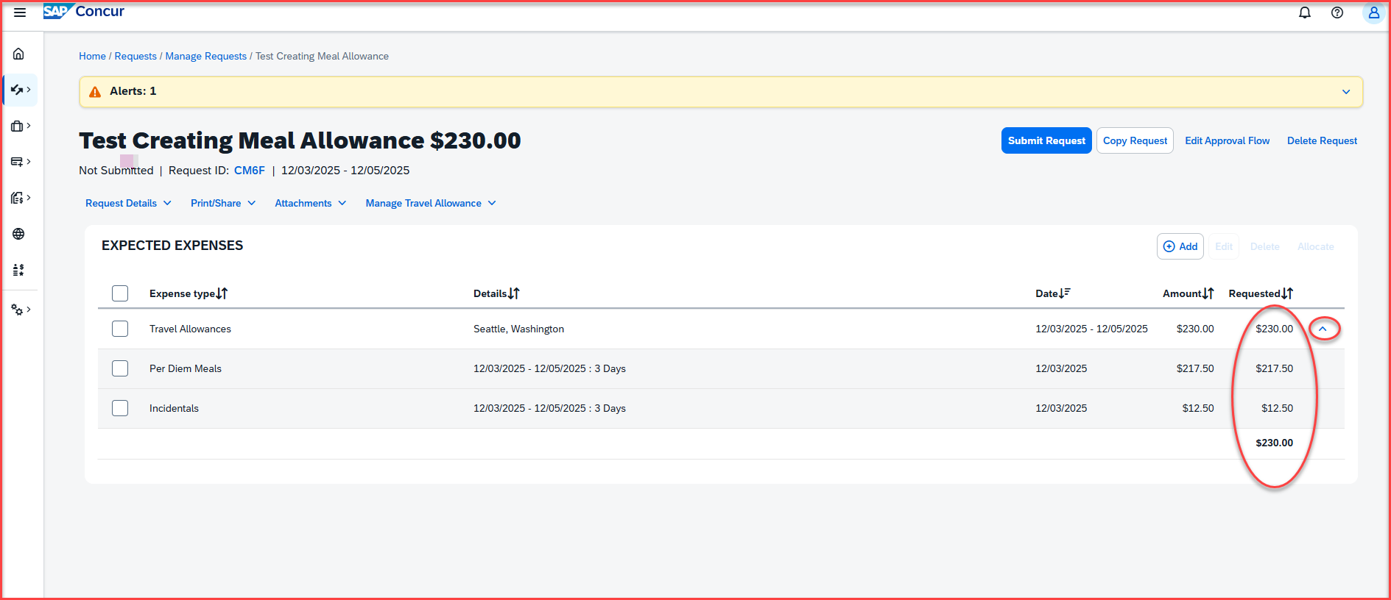
Once you click on Finish, the following screen will appear.
The travel allowance and the incidental amount will be under the Requested section on the far right. Click on the down arow to expand the expense lines. The per diem amount and the incidentals will be for the total of the number of days of the trip

Slide 12
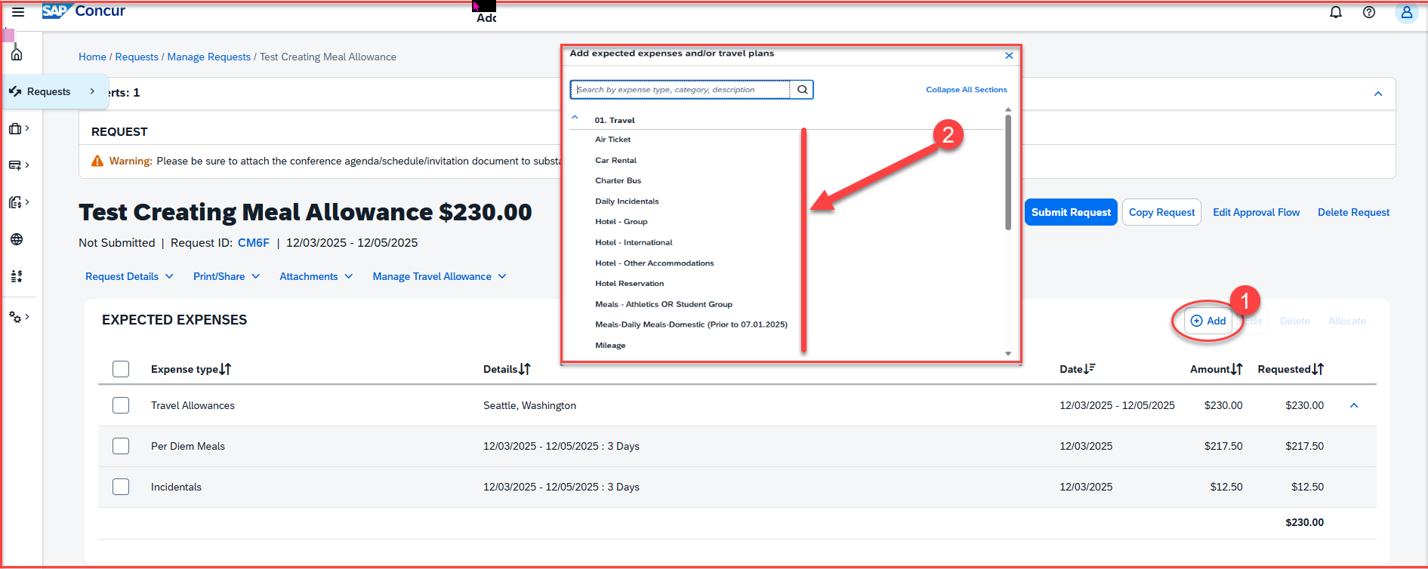
Adding Estimated Expenses: Once the travel meal allowance and incidentals are added, add the remaining estimated expenses
Click on +Add, then add the remaining estimated travel expenses from the dropdown list.
Please note: Lodging for international trips is based on actuals. The expense type will be Hotel International

Slide 13
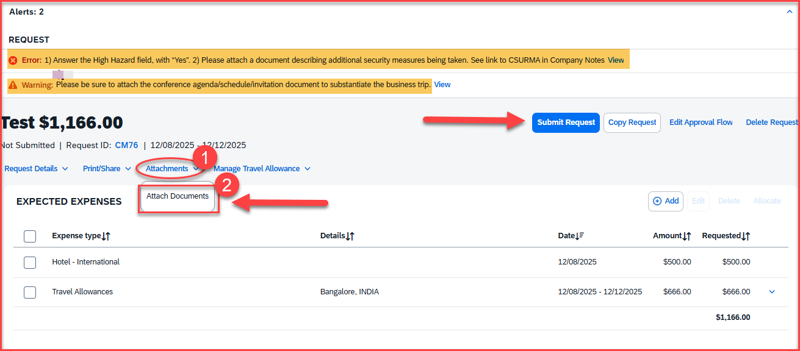
Adding Documents For International Trips
For international trips, the system identifies the high hazard countries based on the destination on the request header. If the country is a high hazard country, the following error will appear:
Error: 1) Answer the High Hazard field, with “Yes”. 2) Please attach a document describing additional security measures being taken. See link to CSURMA in Company Notes
The documents can be attached under the attachment section > Attachments > Attach Documents

Slide 14
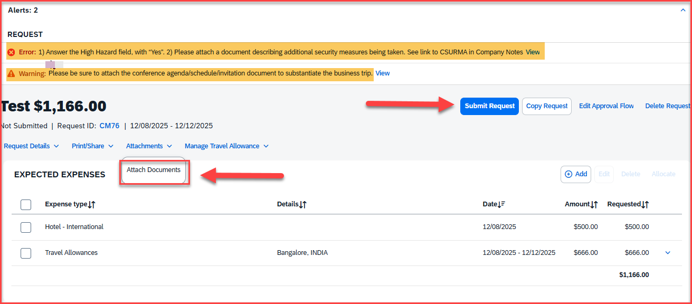
Alerts: Alerts with the red x needs to be cleared. The Warning (triangle) alerts are notifications and won't restrict from submitting the Request. Click on the down arrow to expand and view all the alerts. Once all the alerts are cleared and expenses are added, click on submit request, available at the right-side corner
Please be sure to attach the conference agenda/schedule/document to substantiate the business trip
The documents can be attached under the attachment section > Attachments > Attach Documents

Slide 15
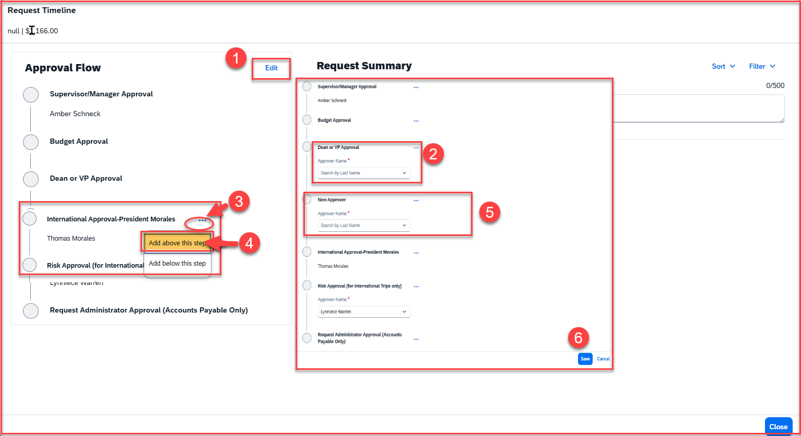
Travel Request Workflow Steps: The approval flow will come up after you click on submit request. Approval Flow is now called Request Timeline
Please note: All international trips must be approved by the campus President. Add the Provost only for Academic Affairs before the President
Click on edit
Select the Dean or VP
For all Academic Affairs only, the Provost must be added before the campus President. Click on the 3 dots
Select Add above this step
Add the Provost
Click on Save, available at the bottom right-side corner

Slide 16
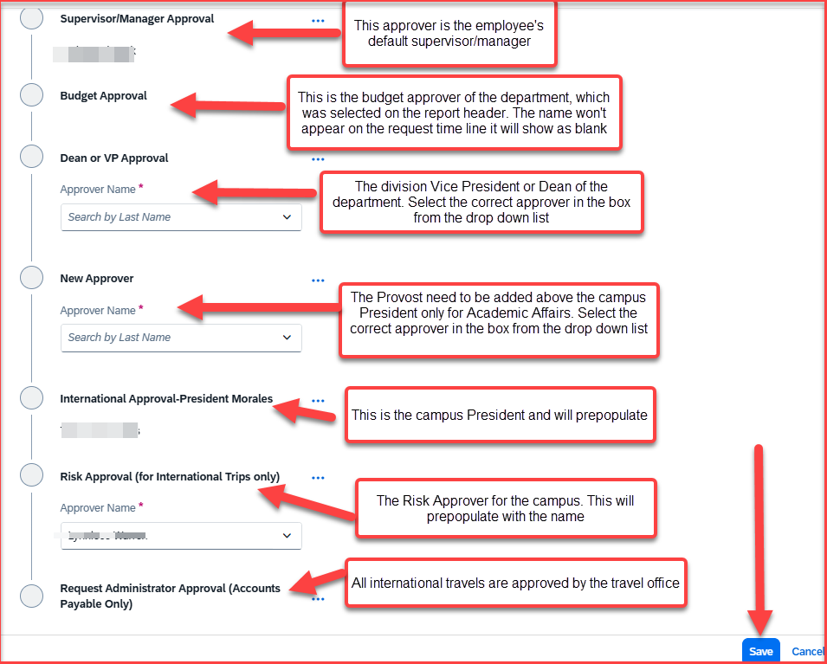
Approval Workflow For International Trips
The International travel request goes through the below approval workflow:
Supervisor/Manager Approval: This approver is the employee's default supervisor/manager
Budget Approval: This is the budget approver of the department, which was selected on the report header. The name won't appear on the request timeline it will show as blank
Dean or VP Approval: The division Vice President or Dean of the department. Select the correct approver in the box from the drop-down list
The Provost: The Provost is needed to be added only for Academic Affairs. Select the correct approver in the box from the drop-down list
International Approval: All international trips must be approved by the campus President and will prepopulate the name
Risk Approval: The Risk Approver for the campus. This will prepopulate with the name
Request Administrator Approval: All international travels are approved by the travel office, and will auto route to AP Travel
Once the approval flow is updated, click on submit – the request will be submitted successfully!

Slide 17
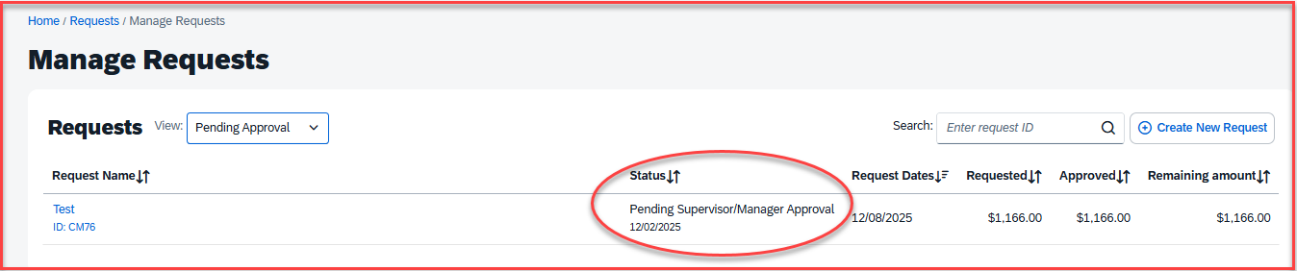
Request Submitted successfully
Once the request is submitted successfully, it will show the pending status until it is fully approved by all the approvers
Please note: each approver has 9 days to approve a Request. If they don’t approve within this timeframe, the Request will time out, and the user will have to resubmit the Request

Slide 18
THANK YOU!
If further information or assistance is needed, please do not hesitate to contact Accounts Payable/Travel at 909-537-5155, or email at – travel@csusb.edu
Notes:
Updated August, 2017 CL

