Slide 1


Verify
Effective: July 28th, 2025

Slide 2
Introduction & Purpose
Verify Checks
Actions For Verify Checks
Expense Approval Workflow

Slide 3

Verify
Introduction
The Verify tool from SAP Concur is an AI-powered expense auditing solution designed to help organizations streamline their expense review process. It automates the auditing of employee-submitted expense reports by checking for potential issues such as duplicate expenses, missing receipts, additional air charges, and incorrect dates, etc. By leveraging machine learning and customizable rule sets, Verify reduces manual review workload, enhances compliance, and helps ensure financial accuracy. The tool can flag high-risk transactions for human auditors, allowing the team to focus its efforts on exceptions and potential fraud, thereby improving efficiency and control.
Purpose
The purpose of the Verify tool is to enhance the integrity, efficiency, and compliance of the expense management process by leveraging AI-powered auditing. Verify automatically reviews submitted expense reports to detect errors once an expense report is submitted, before it moves ahead in the approval workflow. This reduces minimal errors ahead of time, streamlining the review process to be quicker and smoother, and ultimately resulting in a quicker reimbursement.

Slide 4
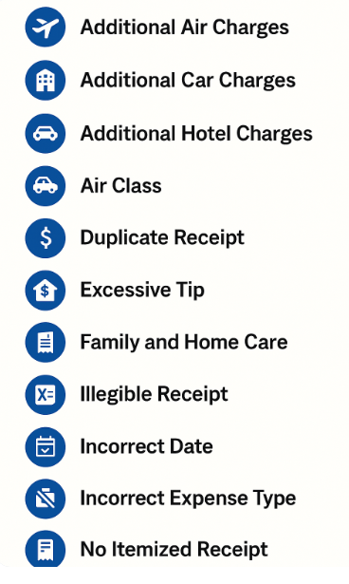

Verify Checks
Our campus has established the 13 verify checks in Concur. Please review the following slides for the detailed explanation of each of these checks and the action needed by users for these checks

Slide 5
Actions For Verify Checks
Additional Air Charges – These charges include airline upgrades like economy plus, lounge access, and seat selections, etc., and are not reimbursable. However, exceptions may be considered for travelers with disabilities when necessary to accommodate their needs. Traveler must obtain pre-approval from HR for such exception and attach the approval to their expense report. Refer to policy for additional details.
  Actions to be taken – Upload necessary documents if the additional expense is due to a disability. If not, exclude the additional amount and update the transaction amount in the expense line item.
Additional Car Charges – These charges include rental car charges like CDW/Insurance, etc., and are not reimbursable.
  Actions to be taken – Exclude the additional insurance charges and update the rental amount under the transaction amount box in the expense line item. Refer to policy for additional details.
Additional Hotel Charges – These charges include mini-bar, in-room/on-demand movies, and are not reimbursable. Refer to policy for additional details.
  Actions to be taken – Exclude the amount under the transaction amount box in the expense line item and claim the remaining amount
Air Class – These charges include air charges other than coach and economy and are not reimbursable. However, exceptions may be considered for travelers when necessary to accommodate their needs. A written justification must be provided and approved in advance. Refer to policy for additional details.
  Actions to be taken – If justifying documentation is not provided, exclude the amount under the transaction amount box in the expense line item and claim the remaining amount
Car Wash – These charges include Car washes or detailing services and are not reimbursable. Refer to policy for additional details.
  Actions to be taken - Please include a justification, mark as personal, or remove from the expense report.
Duplicate Receipt - This means that the expense has a receipt that appears to have been used previously in another expense report. Refer to policy for additional details.
  Actions to be taken - Please add the valid receipt or exclude it from the report and resubmit.

Slide 6
Actions For Verify Checks
Excessive Tip – These charges include tips that are greater than 20% and are not reimbursable. Refer to policy for additional details.
  Actions to be taken - Please include justification or reduce the amount under the transaction amount box in the expense line item
Family and Home Care – These charges include pet, child, elder, and house care and are not reimbursable. Refer to policy for additional details.
  Actions to be taken - Please exclude the charges from the report.
Illegible Receipt – This means that the receipt attached for the expense is not clear enough to analyze the dates and the image is not readable. Examples include low contrast and images with overlapping text, such as watermarks. Refer to policy for additional details.
  Actions to be taken - Please attach a different image of the receipt.
Incorrect Amount – This means that the amount on the receipt is missing, incomplete, or does not match the amount of the expense added on the expense entry transaction amount box. Refer to policy for additional details.
  Actions to be taken – Please add the correct amount under the transaction amount box in the expense line item
Incorrect Date – This means that the date of the receipt is missing, incomplete (Month, Day, and Year required) or does not match the date of the expense claim. Refer to policy for additional details.
  Actions to be taken - Please correct the date discrepancy and update the correct dates.
Incorrect Expense Type – This means that depending on the spend the expense type selected is incorrect. Examples include meal, lodging or airfare. If the types of spend for the receipt and the expense type don't match, this check will raise a flag. Refer to policy for additional details.
  Actions to be taken - Please choose the correct expense type

Slide 7

Actions For Verify Checks
13. No itemized Receipt – This means that the expense do not have an itemized receipt. Refer to policy for additional details.
  Actions to be taken - Please add the itemized receipt to the expense.

Slide 8
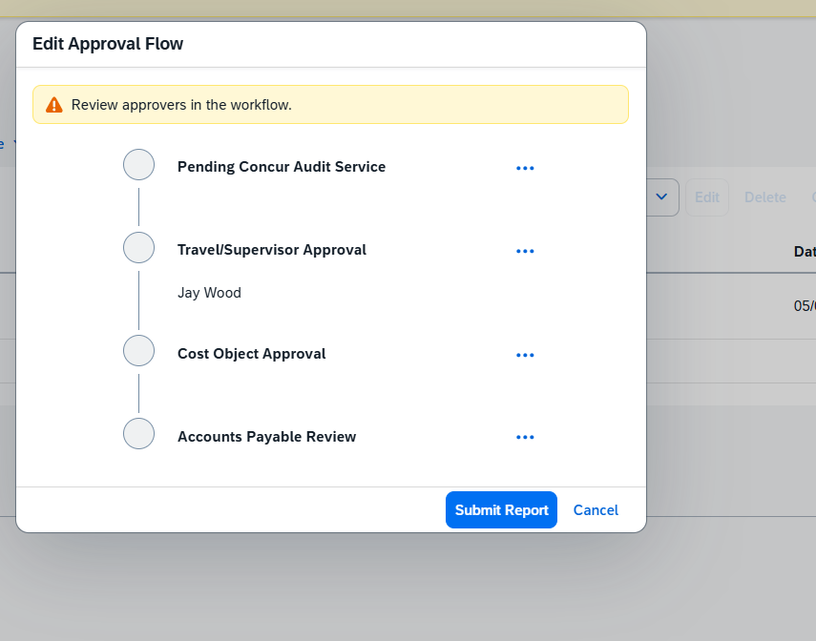
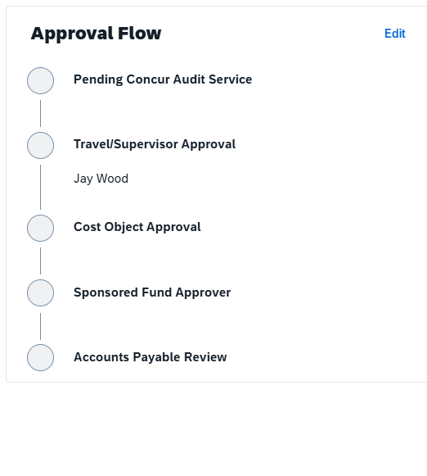
Expense Approval Workflow - Concur
The expense workflow in Concur is going to be as follows
Pending Concur Audit Service
Travel/Supervisor Approval
Cost Object Approval
Accounts Payable Review
Sponsored Program Workflow in Concur will be as follows
Pending Concur Audit Service
Travel/Supervisor Approval
Cost Object Approval
Sponsored Fund Approver
Accounts Payable Review

Slide 9
Thank you!

